Slide 1
STUDENT MENTAL HEALTH: RESULTS FROM THE ACAPT TASK FORCE STUDY
Education and Leadership Conference
October 18, 2020
Notes:
Speaker - Cheryl

Slide 2

TASK FORCE HISTORY
October 2017, ACAPT approved formation of Task Force for Student Mental Health to identify best practices for academic programs to support and improve students’ health and well-being throughout their academic career and in preparation for clinical practice.
Task Force Membership
  1 PT Program Director 2 Clinical Instructors
  1 DCE 1 Student Affairs Director
  1 Student 1 PTA Program Director
  2 Academic Faculty
Notes:
Speaker - Cheryl
In response to request by IPEC of which ACAPT is a member

Slide 3
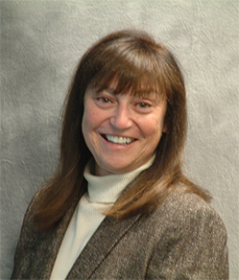
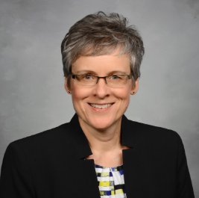
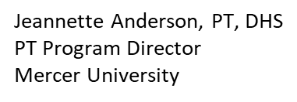

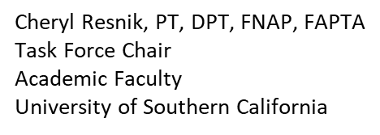
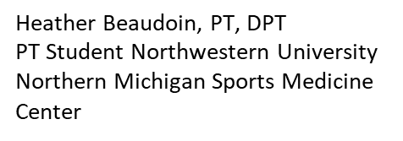
TASK FORCE MEMBERS
Notes:
Speaker - Cheryl

Slide 4
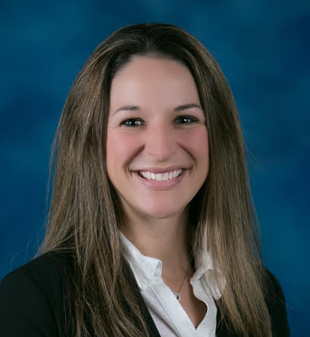
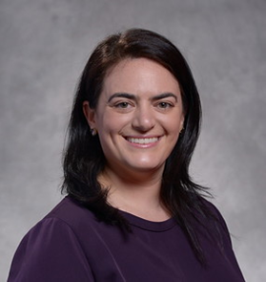
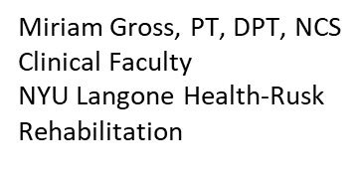
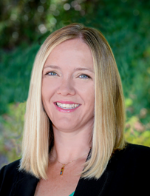
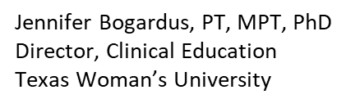
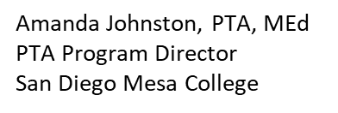
TASK FORCE MEMBERS
Notes:
Speaker - Cheryl

Slide 5
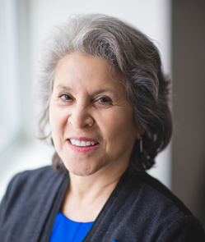

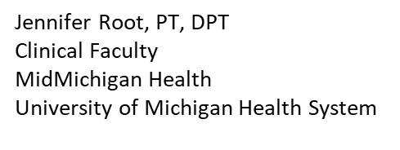
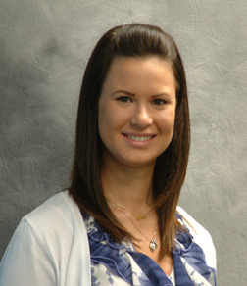
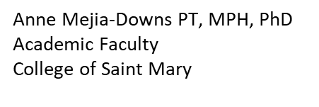
TASK FORCE MEMBERS
Janet Stevenson
Student Affairs
University of Southern California
Notes:
Speaker - Cheryl

Slide 6
TASK FORCE CHARGE
Determine the incidence and impact of mental health dysfunction in physical therapy students
Develop a plan to enhance academic programs awareness to the mental health and wellness needs of physical therapy students
Identify best practices for academic programs to support and improve students’ health and well-being
Raise the visibility of clinician stress and burnout
Provide tools, resources and/or programming related to this area including research areas
Notes:
Speaker - Cheryl

Slide 7


METHODS - SURVEYS
3 Qualtrics surveys were developed and tested in December 2018
IRB approval #HS-19-00169 by USC March 2019
  Academic faculty and staff – N=461
  Program director, DCE, faculty, student affairs personnel
  Clinical faculty – N=242
  10 sites identified by DCEs
  PT and PTA Students – N=1240
  The Pulse, Student Assembly Director of Communications, Core Ambassadors
Task Force To Enhance Academic Programs Awareness to the Mental Health and Wellness Needs of Students and Future Clinicians
Notes:
Speaker – Janet
Process – 3 survey tools were developed
Participants
Faculty – 461 responses (242 ACAPT member institutions) ___ PTA programs
Clinical faculty 209 responses
Students 1200 responses (possible 33,000)

Slide 8
8 DIMENSIONS OF HEALTH/WELLNESS
Emotional—Coping effectively with life and creating satisfying relationships, including sexual relationships
Environmental—Accessing pleasant, stimulating, and safe environments that support all aspects of well-being
Financial—Demonstrating competence with money management to meet current and future financial needs
Intellectual—Recognizing creative abilities and finding ways to expand knowledge and skills
Occupational—Personal satisfaction and enrichment from one’s work
Physical—Recognizing the need for physical activity, adequate and healthy foods, and sleep
Social—Developing a sense of connection, belonging, and a well-developed support system
Spiritual—Expanding a sense of purpose and meaning in life
https://www.samhsa.gov/wellness-initiative/eight-dimensions-wellness
Notes:
Speaker – Janet?
8 dimensions of health/wellness as adapted from the Substance Abuse and Mental Health Services Administration (SAMHSA):

Slide 9
METHODS: Quantitative Analysis
Academic Faculty, PT & PTA programs
Students
Notes:
Speaker – Jeannette

Slide 10
Primary Role in
Physical Therapy Education
Role | % | Count
Faculty Member | 53.47% | 239
PTA Program Director | 14.77% | 66
DPT Program Director or Assistant Director | 12.08% | 54
Director of Clinical Education or Asst. Director of Clinical Education | 10.96% | 49
Student Affairs Director/Staff | 8.72 | 39
Total | 100% | 447
Notes:
For the educational institution members survey, over half of the respondents were faculty members. PTA Program Directors or Assistant Directors had a slightly higher number of responses than DPT Program Directors or Assistant Directors.

Slide 11
Years of Academic/Clinical Experience
Number of Years | % | Count
0-5 | 21.83 | 98
6-10 | 20.49 | 92
11-20 | 27.62 | 124
21 or > | 30.07 | 135
Total | 100 | 449
Notes:
Of those members responding, nearly 60% had 11 or more years of experience.

Slide 12
Student Data
1180 DPT students, 46 PTA students
Program completion
  <50% 467 (38%)
  >50% 760 (62%)

Slide 13
Student Data
Age
  <25 878 (72%)
  26-30 265 (21.6%)
  31-35 61 (5%)
  36-40 16 (1%)
  >41 (0.5%)

Slide 14
Does your institution have a department/office for counseling and psychological services available for students?
Notes:
When asked if their institution has a department or office for counseling and psychological services that is available for their students, approximately 90% reported positively.

Slide 15
Does your program have a protocol or intervention in place in the case of a student's mental health crisis?
Notes:
However, nearly one-quarter of those responding do not have a protocol or intervention process to address students who are having a mental health crisis.

Slide 16
Please identify how frequently you have encountered the following issues with your students
1 = Never
2 = Rarely
3 = Occasionally
4 = Frequently
Notes:
Faculty were asked to identify on a 4-point likert scale how frequently they have encountered various issues and concerns with their students.

Slide 17
How prepared do you feel to manage the following student issues?
1 = Not prepared
2 = Somewhat prepared
3 = Very prepared
Notes:
Faculty were also asked to rate on a 3-point likert scale how prepared they felt to manage the student issues.

Slide 18
Issues addressed on survey
Academic performance anxiety
Anxiety (generalized, social, panic attack, etc.)
Clinical performance anxiety
Depression
Nutrition (eating disorder, food insecurity)
Environmental safety (disasters, housing insecurity)
Financial strain
Grief due to loss
Perceived social isolation and loneliness
Psychotic episode
Post-Traumatic Stress Disorder
Relationship issues
Sexual abuse, sexual assault (including domestic partner)
Student health issues
Substance abuse
Suicide ideation or attempt
Notes:
The two previously mentioned questions were rated for each of these 16 potential issues.
Next, we’ll discuss the top 5 most frequently reported issues according to the faculty, and compare student frequency of experiencing the issues. Student and faculty confidence to address the specific issue is also provided.

Slide 19
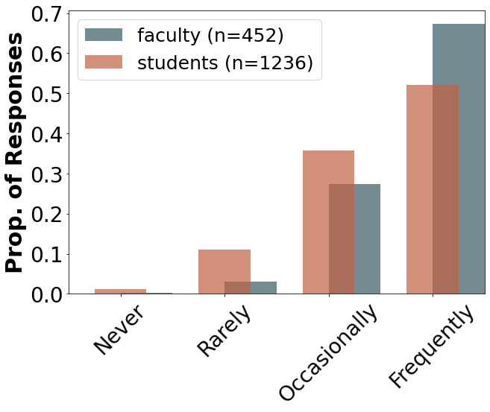
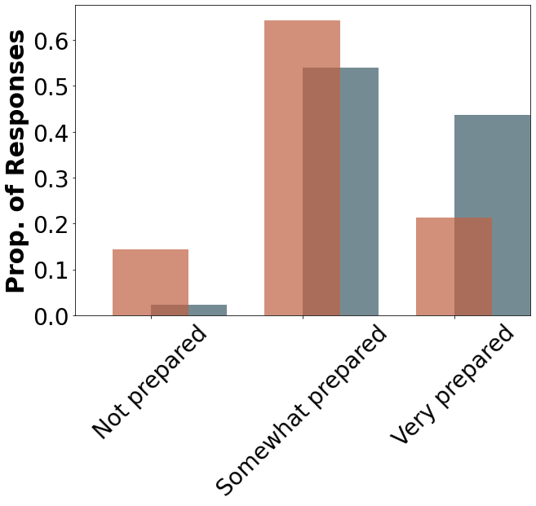
Academic Performance Anxiety
Notes:
The perception of frequency of academic performance anxiety is the highest, and fairly consistent, between faculty and students. As expected, faculty report feeling more prepared than students in addressing the issues.

Slide 20
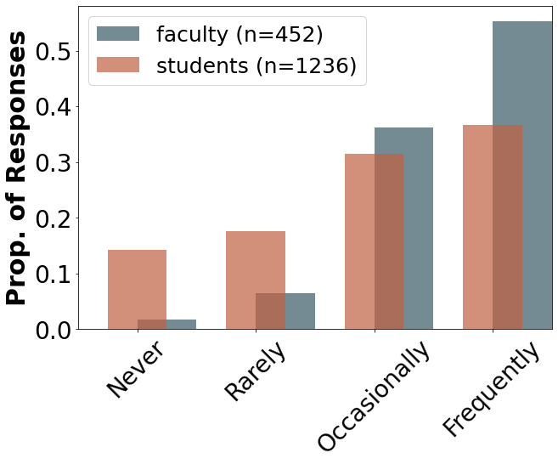
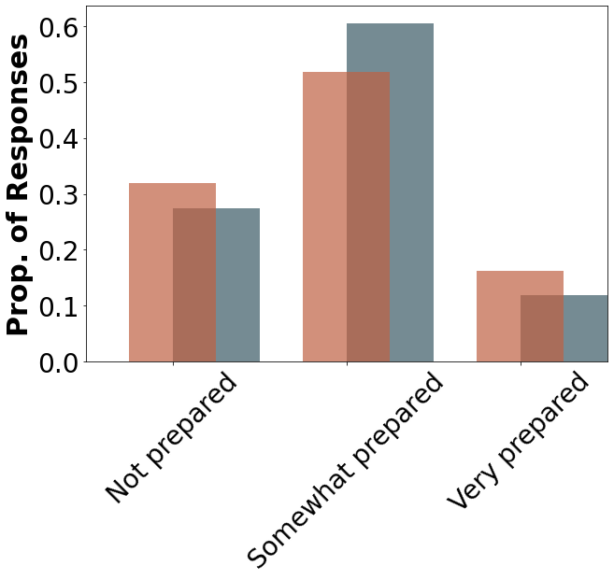
Financial Strain
Notes:
Faculty report students have a high frequency of financial strain concerns. Students report an occasional to high frequency of financial strain concerns. Interestingly, slightly more students report being “very prepared” to address the concerns in comparison to faculty. Overall, faculty report being only slightly more prepared than students to address these concerns.

Slide 21
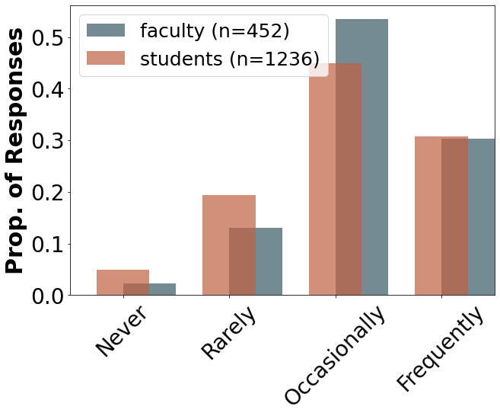
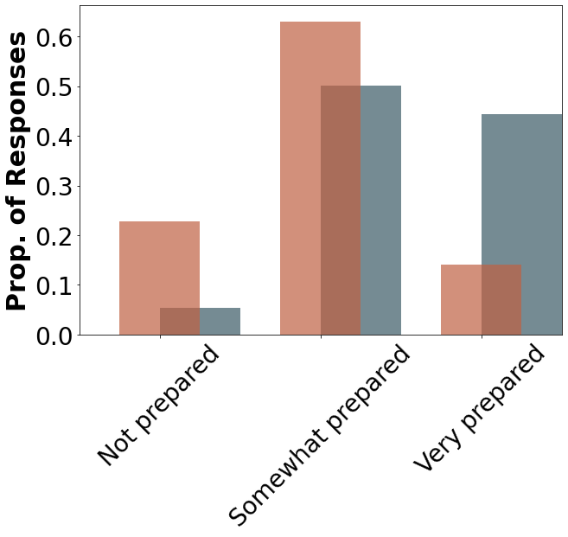
Clinical Performance Anxiety
Notes:
Faculty perceive an occasional to high frequency of clinical performance anxiety, which is slightly overestimated compared to the frequency reported by students. Again, as expected, faculty report feeling much more prepared to address the students’ concerns.

Slide 22
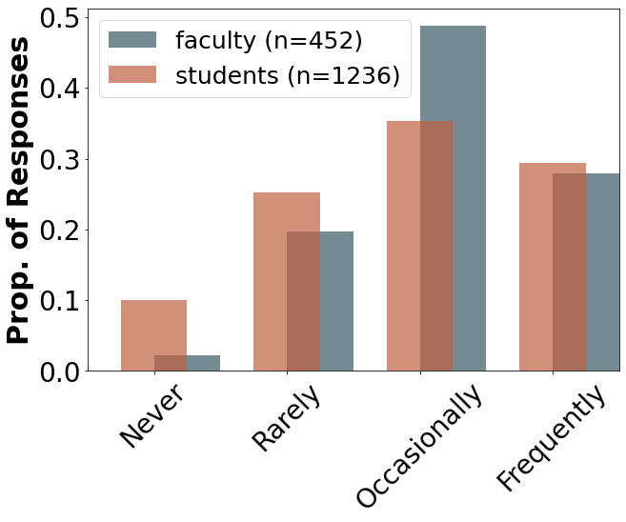
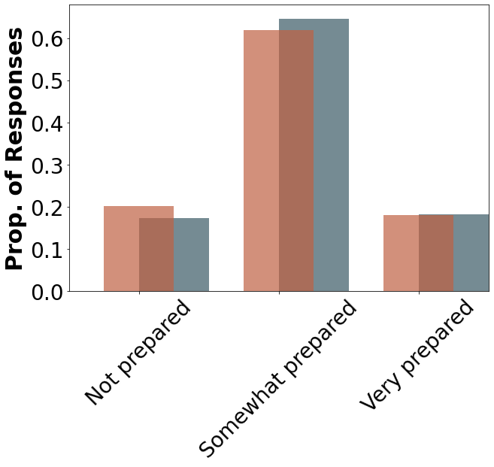
Generalized Anxiety
Notes:
Faculty perceive occasional and frequent reports of generalized anxiety more often than students perceive this issue. Confidence in addressing generalized anxiety is nearly the same between students and faculty

Slide 23
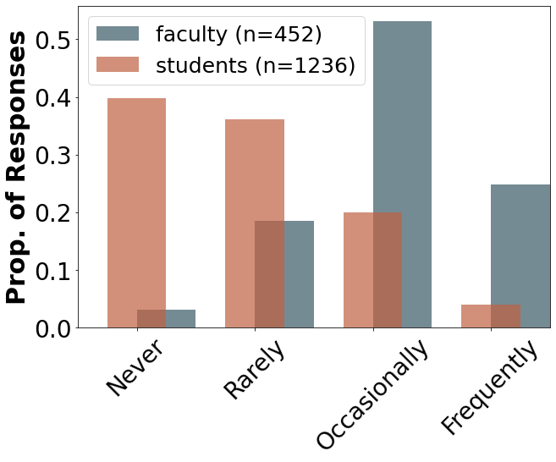
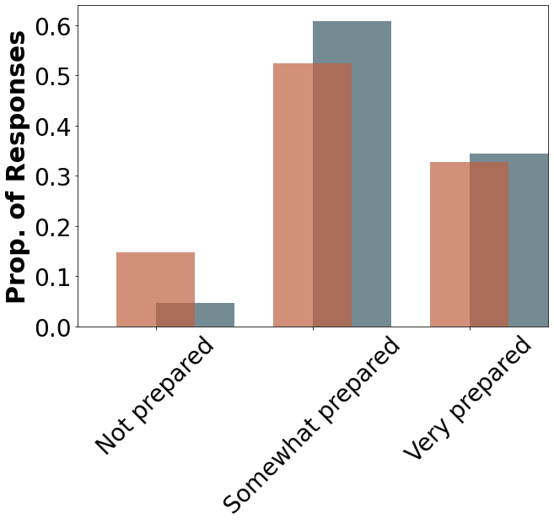
Student Health Issues
Notes:
Faculty perceive a much higher frequency of student health issues than those reported by students. Faculty and student preparation to address these issues appear fairly consistent.

Slide 24
Faculty reported “rarely” or “never”
Needing to address student concerns related to:
    Environmental Safety (disasters, housing, neighborhood)
    Post-traumatic Stress Disorder
    Substance Abuse
    Sexual Abuse or Assault
    Suicidal Ideation or Attempt
    Psychotic Episode
  Consistent with student reports
Notes:
Faculty reported they rarely or never experienced students reporting these identified issues. These were also consistent with student reports.

Slide 25
Students reported “rarely” or “never”
Experiencing concerns related to:
    Depression
    Grief due to Loss
    Nutrition
    Social Isolation
    Student Health Issues
    Relationship Issues
Notes:
As discussed previously, faculty perception of student health issues appears overestimated compared to student reports. This overestimation occurs across the other identified topics on this slide.

Slide 26
Faculty Perception of Being “Not Prepared”
Notes:
This slide identifies the top 6 rated issues that faculty do not feel prepared to address.
This relates well to student perceptions of not feeling prepared to address these concerns.
Students report feeling least prepared to address psychotic episodes and PTSD (48%), then, sexual abuse (38%), financial strain 32%, grief due to loss and suicide 30%.
Students feel more prepared to address nutritional and substance abuse than faculty.

Slide 27
METHODS: Qualitative Analysis
Themes were identified (coded) from the responses to open-ended survey questions
Three groups of task force member researchers analyzed data:
  Responses from DPT and PTA faculty
  Responses from clinical faculty
  Responses from students
The themes that were coded were rechecked with other researchers for agreement

Slide 28
WHAT DO YOU FEEL ARE YOUR STRENGTHS IN SUPPORTING STUDENTS’ WELLNESS NEEDS?
Academic Faculty

Slide 29
Theme: Faculty Characteristics
Approachable; use compassion and listening skills
“Being accessible and providing an avenue for students to communicate their needs…”
“Our faculty care about our students and want them to succeed…”
”Open door policy, proactive in identifying…student issues…”
“Active listening”

Slide 30
Theme: Faculty Characteristics
Knowledge and experience with mental health issues
“Understanding of importance of physical, mental, spiritual well-being with work-life balance”
“…I feel capable recognizing students who are struggling.”
“I have been trained to assess mental health issues…”
“I have a good understanding of the resources…”

Slide 31
Theme: Resources
Identify institutional and community resources
“Campus resources are available at any time of day”
“…outside resources that can aid is assisting students with wellness.”
“adding counseling center to orientation”
”…part of the mission and culture of our institution.”

Slide 32
Theme: Program Attributes
Culture of the program; advising practices
“One-on-one discussion with faculty to convey support…”
“Strong relationships between faculty and students”
“Creating a socially supportive environment to students”
“We all have the same goal, we want the student to succeed…”

Slide 33
Theme: Actions
Problem recognition and referrals; acting as a role model
“assist them in getting to the [counseling] center as needed”
“Modeling wellness behaviors”
“Identifying needs in a timely manner before they become barriers to student success”
“Approaching the subject when noticing something is wrong vs waiting for the student to seek help”

Slide 34
WHAT DO YOU FEEL ARE YOUR STRENGTHS IN SUPPORTING STUDENTS’ WELLNESS NEEDS?
Clinical Faculty

Slide 35
Theme: Compassionate Communication
Ability to be active listeners; to utilize behavior that is empathic and compassionate
“Ability to listen intently and allow the student to express their needs/concerns without judgement”
“I think it starts with open communication; allowing the student to feel comfortable talking with you so they will inform you of any issues.”
“Encouraging to take good care of one's self spiritually, emotionally, physically.”

Slide 36
Theme: Relatability
Sense of relatability by way of personal experience
“Having been a student recently, I can relate to many of their struggles or concerns.”
“Clinical and personal experience with several topic areas...”
“I also had test anxiety & know how to help students.”
“I also have personal experience with depression and anxiety.”

Slide 37
Theme: Resource & Referral Support
Ability to initiate a referral, locate resources internally or with student’s university
“I have the ability to find the right person to help the student's wellness needs.”
“Inpatient and outpatient mental health services on site.”
“We have a large Education Department who can assist and may be able to adapt Employee protocols for students.”

Slide 38
Theme: Empathic Personality Traits
Personality characteristics that provide supportive & empathic approach
“I encourage work-life balance and … positive relationships between CI and students that often include wellness discussions beyond clinical expectations…”
“Taking into consideration with kindness their personal situations that may affect clinical attendance.”
“Patience, dedication, and commitment.”

Slide 39
WHAT ARE YOUR CONCERNS IN SUPPORTING STUDENTS’ WELLNESS NEEDS?
Academic Faculty

Slide 40
Theme: Faculty Characteristics
Lack of experience or knowledge of how to handle mental health issues
“Would like to know what else we can do”
”I do not feel I have the training to help students with their mental health…”
“That the student’s needs are at a critical level before I am aware of them"
“Getting too emotionally attached to the student and the issues”

Slide 41
Theme: Program Attributes
Culture of the program doesn’t promote mental health
“Not enough focus on the entire student; not just the academic performance of students”
“There is little to no time in our curriculum for students to take a break to recover from a negative event.”
“Current educational and assessment practices create high-stakes testing that only amplifies stress and anxiety”

Slide 42
Theme: Student-Related Attributes
Behavior & types of problems makes addressing mental health issues challenging
“Students are not always comfortable or forthcoming in addressing issues for fear of failure.”
“Increasing numbers of students and complexity of needs”
“Financial/housing insecurity are tough to address”
“[Their] resistance to resources that could help with their overall wellness”

Slide 43
WHAT ARE YOUR CONCERNS IN SUPPORTING STUDENTS’ WELLNESS NEEDS?
Clinical Faculty

Slide 44
Theme: Not My Concern, It’s Yours (Institution)
Primary responsibility for wellness should rest with university
“I believe that the responsibilities you have outlined are between the student and their institution; not the site where they are interning.”
“My initial instinct is to refer them back to the PTA program.”
“We are here to provide support in learning to perform tasks of PT. [I am] less oriented to feeding/housing/or providing mental health services to students.”

Slide 45
Theme: Not My Concern, It’s Yours (Student)
Outside scope of clin ed; differences in generations and today’s student
“Sorry, I’m a baby boomer. Millennial hand holding is not a big concern of mine.”
“It’s hard for me to get past the way I was raised (“suck it up buttercup”) and realize kids these days are much more fragile and sensitive.”
“Student wellness needs seem to be mounting as the years pass, and the millennial generation seems to need more and take less responsibility.”

Slide 46
Theme: Lack of Time
Time constraints related to resources, patient care, and productivity
“Clinical performance (number of patients to be seen) is not decreased when having a student, so it is difficult to take the time for other things.”
“If there were a major crisis, [my concern is] that we would be neglectful of our job duties in supporting the student.”
“[My concern is] taking time from learning opportunities.”

Slide 47
Theme: Underqualified & Unprepared
Lack of preparedness & training in managing mental health issues
“Most CI’s are not going to be competent in handling these issues and should not try if not competent.”
“We are not prepared for a student to have a mental breakdown in the clinic.”
“I don’t know how to help when students have emotional/psychological baggage from prior experiences that impacts their clinical experience.”
“I feel inadequate with dealing with students who may have depression, financial strain, or sexual abuse.”

Slide 48
Theme: Breaking Boundaries
Concerns about own personal boundaries with respect to students
“Maintaining privacy, as most situations, I would want to refer back to the school, but that can be an issue with privacy unless the student is in danger.”
“I believe some students will not open up about any outside issues that they are experiencing.”
[I am concerned about] “setting appropriate boundaries.”
“I’m concerned that students won’t ask for help as much as they should and recognize it’s not a sign of weakness but helps make the clinic better.”

Slide 49
Student Themes
Institutional Strengths
Supportive faculty – available, approachable, caring
University services – counseling center, gym access

Slide 50
Student Themes
Institutional Weaknesses
Access to care – remote campuses, inflexible hours of operation, unavailable during remote clinicals, waitlist
Financial support – literacy, wellness, assistance
Curriculum – unsupportive of student wellness, course load, exam schedule, conflicts with stated values re: mental health
Faculty – recognition of students in distress, lack of compassion

Slide 51

What Next?
Students: We hear you!
Notes:
Students need to know they are heard. Now, more than ever, we need human connection. We, as academic and clinical faculty, must take the time to listen to and understand our students. The old mantras of self-sufficiency – the “suck it up, buttercup” and “I suffered through PT school and you can too” attitudes are just not going to cut it. If we want to maintain a strong and resilient profession, we can’t ignore these mental health needs. We must address them proactively, and then know how to react in times of crisis.

Slide 52
Suggestions –
Immediate Action Steps
Identify what mental health resources are already available – make them widely known
Set up regular meetings with advisors/mentors (once per semester)
Be pro-active in creating response algorithms/protocols for mental health crises
Compile information on mental health related resources to provide to clinical sites
Advocate for expanding access to online counseling/ support programs – especially for students at distant clinical sites
Consider providing “Financial Literacy Training”
Notes:
ID what is available – De-stigmatize mental health issues – have counseling/support services listed alongside library, writing center, other student services
Online – “Never miss an opportunity to take advantage of a crisis”.

Slide 53





TASK FORCE CHARGE – Future plans
Determine the incidence and impact of mental health dysfunction in physical therapy students
Develop a plan to enhance academic programs awareness to the mental health and wellness needs of physical therapy students
Identify best practices for academic programs to support and improve students’ health and well-being
Raise the visibility of clinician stress and burnout
Provide tools, resources and/or programming related to this area including research areas
Notes:
With these 3 surveys, we better understand the incidence of mental health dysfunction in our PT and PTA students. And while it’s impossible to directly correlate the incidence with the impact of these issues, we can indeed surmise that issues such as anxiety, depression, loneliness, financial pressures and others affect our students’ ability to learn and develop as clinicians and therefore affect the patients they encounter.
In order to enhance academic programs awareness of these needs, we hope to publish our results and recommendations in the JOPTE.
This aim may best be addressed by a comprehensive literature review of best practices, even in other professions such as medicine, nursing, dentistry and veterinary medicine, to support students’ health and well-being.
We have come to realize that addressing clinician stress and wellness may be outside the scope of this task force. It may be more appropriate to make a motion to the APTA HOD to address these issues among clinicians.
Our next big step is to do just this – to provide tools and resources for programs and individuals to be more prepared to address these issues. To encourage programs to educate their faculty on resources already available within their universities and colleges and to create action plans for crisis situations. To develop resource guides for DCEs to give to their clinical partners. To empower all faculty (academic and clinical) to recognize and address mental health and wellness needs of their students. And, possibly, to conduct follow-up long-term research.

Slide 54
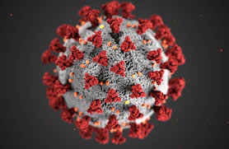




Notes:
We completed our research surveys just before Covid 19 arrived. We can only speculate on how stressors have increased in our students in the last 6 months. And yet Covid is just one example, albeit a huge one, of how life can be unexpected and hard. Challenges such as natural disasters, political issues, racial injustice, and of course personal struggles compound the stress and strain for all of us.
So while we need to teach our students the origin and insertion of the sartorius, and how to work a goniometer, and all the other really critical components of the profession, we also have to see them as people, and do what we can to support their health and wellness throughout their academic career and in preparation for clinical practice.

Slide 55

Special Thanks
Rini Varghese, PT, MS, PhD Candidate
for her assistance on data analysis

Slide 56
Thank you!
Please send questions for the Task Force addressed to: resnik@pt.usc.edu

