Slide 1
Diagnostic Clinical Reasoning Worksheet
Jennifer Jeffrey Bell, PT, ScD, COMT
Director of Clinical Education
University of Montana
School of Physical Therapy and Rehabilitation Science

Slide 2
Diagnostic Clinical Reasoning Worksheet
Worksheet (paper or word document)
Based on an upcoming initial evaluation
Guides the student to formalize a differential diagnoses list that aides in determining the patient’s diagnosis

Slide 3
Diagnostic Clinical Reasoning Worksheet
Why did we create this?
Help students through the diagnostic process
Improve clinical reasoning skills
Learning objectives:
Select appropriate diagnoses based off patient demographics
Describe patient presentation for each diagnosis
Compare their patient’s presentation to those outlined on worksheet
Rule in/out medical conditions causing the pt’s complaints
Synthesize data from worksheet and patient exam to determine pt’s diagnosis

Slide 4
Diagnostic Clinical Reasoning Worksheet
Assigned
Student-directed
Completed
In the clinic
Reviewed
Prior to evaluation
CI-directed
At home
Independently
Collaboratively
At each step
And during evaluation
DCE-directed
Notes:
We either tell students at the beginning of their experience that they need to complete X number of these on new evaluations or, if we have some downtime and know an IE is coming up, student is assigned to complete it

Slide 5
How much work is this for me??
Diagnostic Clinical Reasoning Worksheet
Can be self-directed by the student
Guides the student’s clinical reasoning/planning discussion with CI prior to Evaluation
Completed in collaborative learning model
  With student partner
  With student from another profession

Slide 6
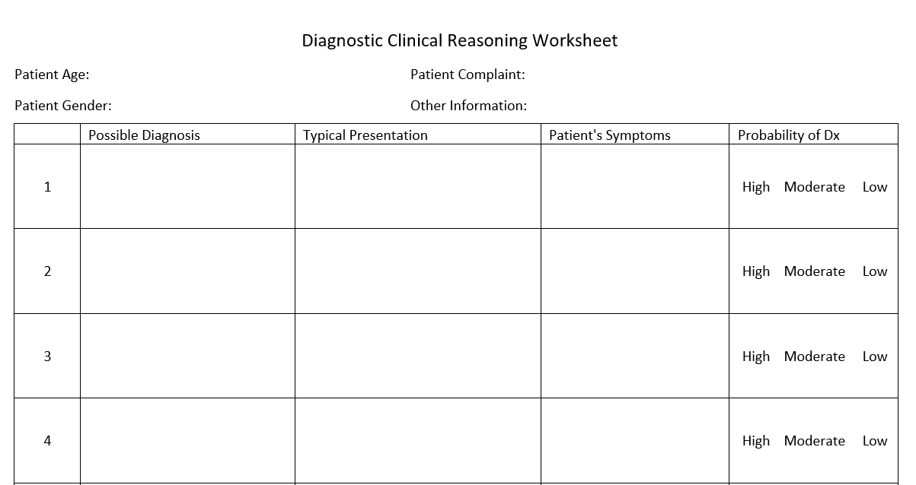

Slide 7
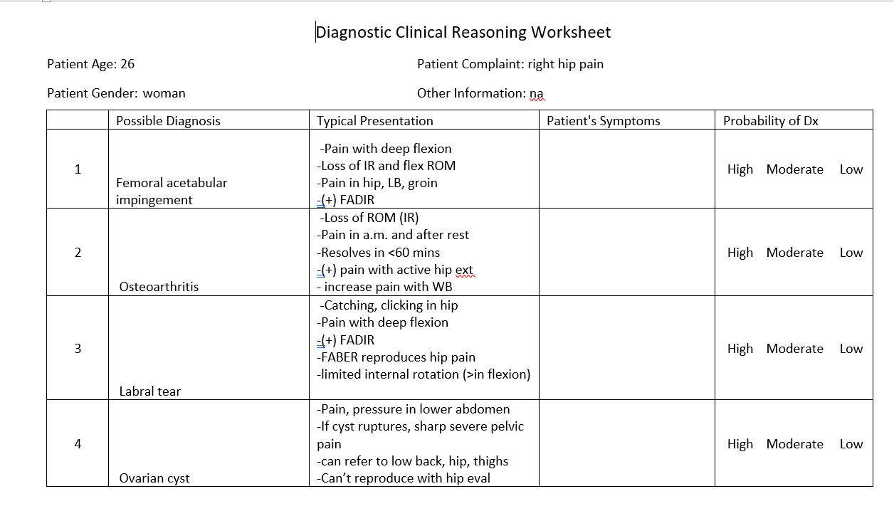

Slide 8
Who is this tool for?
Can be used with any level of student
  But expectations vary
Can be used in a variety of settings
  Outpatient Ortho
  Acute care
  Pediatrics
  Neuro
  Others?

Slide 9
Questions? Comments? Thoughts?

