Slide 1

Integrating and Assessing the New CAPTE Interprofessional Education Standards in the Clinic
Cheryl Resnik, PT, DPT, FNAP
Debora Brown, PT, DPT, FNAP
Samantha Brown, PT, DPT
Robert W. Nithman, PT, DPT, GCS
Pamela D. Ritzline, PT, EdD

Slide 2

Objectives
1. Summarize the CAPTE IPE standards and their relationship to the IPEC core competencies
2. Explain the value of incorporating the core competencies to promote clinical excellence to clinical partners
3. Identify instructional strategies to prepare students and academic and clinical faculty for integration of IPE into the clinical setting
4. Design IP activities for their students’ use in the clinic based upon the core competencies
National Interprofessional Education Consortium

Slide 3
Outline
1. IPE & collaborative practice definition and goals, Triple Aim and quality outcome measures
2. Review of IPEC core competencies
3. CAPTE standards review
4. Examples of objectives and specific CAPTE outcome assessments
5. Examples of instructional strategies
6. Implementation requirements
7. Integrating the clinical instructor community

Slide 4

What is Interprofessional Education (IPE)?
“Interprofessional education occurs when students from two or more professions learn about, from, and with each other to enable effective collaboration and improve health outcomes. Once students understand how to work interprofessionally, they are ready to enter the workplace as a member of the collaborative practice team. This is a key step in moving health systems from fragmentation to a position of strength.”
Source: World Health Organization (WHO). (2010). Framework for action on
interprofessional education & collaborative practice. Geneva: World Health Organization.
See http://whqlibdoc.who.int/hq/2010/WHO_HRH_HPN_10.3_eng.pdf.

Slide 5
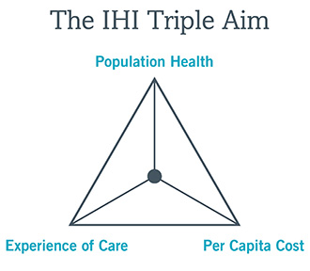
Institute for Healthcare Improvement: The IHI Triple Aim
A framework for optimizing health system performance by simultaneously focusing on the health of a population, the experience of care for individuals within that population, and the per capita cost of providing that care..
Notes:
The Institute for Healthcare Improvement (IHI), an independent not-for-profit organization based in Cambridge, Massachusetts, is a leading innovator, convener, partner, and driver of results in health and health care improvement worldwide.
IHI was officially founded in 1991, but our work began in the late 1980s as part of the National Demonstration Project on Quality Improvement in Health Care, led by Dr. Don Berwick and a group of visionary individuals committed to redesigning health care into a system without errors, waste, delay, and unsustainable costs. Since then, we’ve grown from an initial collection of grant-supported programs to a self-sustaining organization with worldwide influence.

Slide 6
The Interprofessional Education Collaborative (IPEC)
In 2009 six national education associations of schools of the health professions formed a collaborative to promote and encourage efforts that would advance substantive interprofessional learning experiences to help prepare future health professionals for enhanced team-based care of patients and improved population health outcomes.
https://ipecollaborative.org/About_IPEC.html

Slide 7
Founding members
• American Association of Colleges of Nursing (AACN)
• American Association of Colleges of Osteopathic Medicine (AACOM)
• American Association of Colleges of Pharmacy (AACP)
• American Dental Education Association (ADEA)
• Association of American Medical Colleges (AAMC)
• Association of Schools and Programs of Public Health (ASPPH)

Slide 8
New institutional members
• American Association of Colleges of Podiatric Medicine (AACPM)
• American Council of Academic Physical Therapy (ACAPT)
• American Occupational Therapy Association (AOTA)
• American Psychological Association (APA)
• Association of American Veterinary Medical Colleges (AAVMC)
• Association of Schools and Colleges of Optometry (ASCO)
• Association of Schools of Allied Health Professions (ASAHP)
• Council on Social Work Education (CSWE)
• Physician Assistant Education Association (PAEA)

Slide 9
Supporting organizations
• Academic Consortium for Complementary & Alternative Health Care (ACCAHC)
• American Physical Therapy Association (APTA)
• American Speech-Language-Hearing Association (ASHA)
• Association of Schools of Allied Health Professions (ASAHP)
• Society of Simulation in Healthcare (SSH)

Slide 10
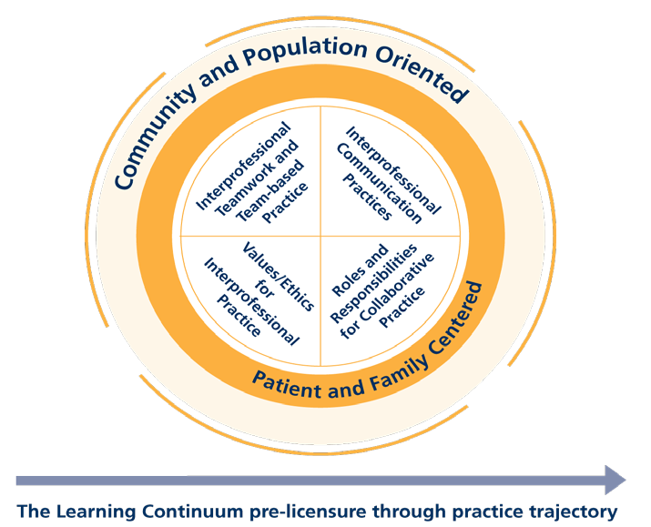
Interprofessional Collaboration Competency Domain

Slide 11
Four Core Competencies
The core competencies and sub-competencies feature the following desired principles:
  patient and family centered
  community and population oriented;
  relationship focused;
  process oriented;
  linked to learning activities, educational strategies, and behavioral assessments that are developmentally appropriate for the learner;
  able to be integrated across the learning continuum;
  sensitive to the systems context and applicable across practice settings;
  applicable across professions;
  stated in language common and meaningful across the professions; and
  outcome driven
  https://ipecollaborative.org/uploads/IPEC-2016-Updated-Core-Competencies-Report__final_release_.PDF
Notes:
Originally disseminated in 2011

Slide 12
Competency 1
Work with individuals of other professions to maintain a climate of mutual respect and shared values.
(Values/Ethics for Interprofessional Practice)
VE5 Work in cooperation with those who receive care, those who provide care, and others who contribute to or support the delivery of prevention and health services and programs.

Slide 13
Competency 2
Use the knowledge of one’s own role and those of other professions to appropriately assess and address the health care needs of patients and to promote and advance the health of populations.
(Roles/Responsibilities)
RR3. Engage diverse professionals who complement one’s own professional expertise, as well as associated resources, to develop strategies to meet specific health and healthcare needs of patients and populations.

Slide 14
Competency 3
Communicate with patients, families, communities, and professionals in health and other fields in a responsive and responsible manner that supports a team approach to the promotion and maintenance of health and the prevention and treatment of disease.
(Interprofessional Communication)
CC3. Express one’s knowledge and opinions to team members involved in patient care and population health improvement with confidence, clarity, and respect, working to ensure common understanding of information, treatment, care decisions, and population health programs and policies.

Slide 15
Competency 4
Apply relationship-building values and the principles of team dynamics to perform effectively in different team roles to plan, deliver, and evaluate patient/population-centered care and population health programs and policies that are safe, timely, efficient, effective, and equitable.
(Teams and Teamwork)
TT9. Use process improvement to increase effectiveness of interprofessional teamwork and team-based services, programs, and policies.

Slide 16
Interprofessional Education and
CAPTE
IPE
IPE education
CAPTE
IPE collaboration
National Interprofessional Education Consortium

Slide 17

New CAPTE Standards
Effective date
Definitions
Standards and Elements
Interprofessional Competency Domains
National Interprofessional Education Consortium

Slide 18

New CAPTE Standards
Effective date
National Interprofessional Education Consortium

Slide 19
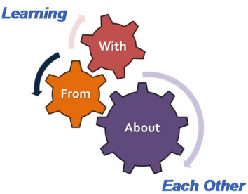
CAPTE Definitions
Interprofessional Education
Occurs when two or more professions learn with, from and about each other to improve collaboration and the quality of care. (WHO, 2002)
National Interprofessional Education Consortium

Slide 20

CAPTE Definitions
Interprofessional Practice
When multiple health workers from different professional backgrounds work together with patients, families, carers [sic], and communities to deliver the highest quality of care. (WHO, 2010)
National Interprofessional Education Consortium

Slide 21

New CAPTE Standards
Standards and Elements
  6F
  6L3
  7D7
  7D28
  7D37
  7D39
s
National Interprofessional Education Consortium

Slide 22
Interprofessional Collaborative Practice Competency Domains
Competency Domain 1 (VE1 – VE10)
  Values/Ethics for Interprofessional Practice
Competency Domain 2 (RR1 – R9)
  Roles/Responsibilities
Competency Domain 3 (CC1- CC8)
  Interprofessional Communication
Competency Domain 4 (TT1 – TT11)
  Teams and Teamwork
Interprofessional Education Collaborative Expert Panel. (2011).
Core competencies for interprofessional collaborative practice:
Report of an expert panel. Washington, D.C.:
Interprofessional Education Collaborative.
National Interprofessional Education Consortium

Slide 23
CAPTE Standard 6F
The didactic and clinical curriculum includes interprofessional education; learning activities are directed toward the development of interprofessional competencies including, but not limited to, values/ethics, communication, professional roles and responsibilities, and teamwork.
NOTE: Effective January 1, 2018
Correlates with all 4 IPEC Competency Domains
National Interprofessional Education Consortium
Notes:
Describe learning activities that involve students, faculty and/or practitioners from other health care professions.
Describe the effectiveness of the learning activities in preparing students and graduates for team-based collaborative care.

Slide 24
CAPTE Standard 6L3
6L The curriculum plan includes clinical education experiences for each student that encompass, but are not limited to:
6L3 involvement in interprofessional practice
(VE5, RR4, RR6, RR7, RR8, RR9, CC2, CC3, CC4, CC8, TT3, TT4, TT7, TT11)
National Interprofessional Education Consortium
Notes:
Describe the program’s expectation for opportunities for involvement in interprofessional practice during clinical experiences.
Provide evidence that students have opportunities for interprofessional practice.

Slide 25
CAPTE Standard 7D7
Professional Ethics, Values and Responsibilities
Communicate effectively with all stakeholders, including patients/clients, family members, caregivers, practitioners, interprofessional team members, consumers, payers, and policymakers.
(VE5, RR1, RR3, RR4, RR6, RR7, CC1-CC8, TT6)
National Interprofessional Education Consortium

Slide 26
CAPTE Standard 7D28
Management of Care Delivery
Manage the delivery of the plan of care that is consistent with professional obligations, interprofessional collaborations, and administrative policies and procedures of the practice environment.
(VE5, VE6, VE7, VE9, VE10, RR1, RR2, RR5, RR8, CC3, TT3, TT4, TT7, TT10)
National Interprofessional Education Consortium

Slide 27
CAPTE Standard 7D37
Participation in Health Care Environment
Assess and document safety risks of patients and the healthcare provider and design and implement strategies to improve safety in the healthcare setting as an individual and as a member of the interprofessional healthcare team.
(VE1, VE5, VE7, VE10, RR2, RR5, RR6, TT3, TT7, TT9, T10, TT11)
National Interprofessional Education Consortium

Slide 28
CAPTE Standard 7D39
Participation in Health Care Environment
Participate in patient-centered interprofessional collaborative practice.
(VE1, VE2, VE3, VE4, VE7, VE9, RR9, CC2, CC3, CC8, TT2, TT3, TT4)
National Interprofessional Education Consortium

Slide 29
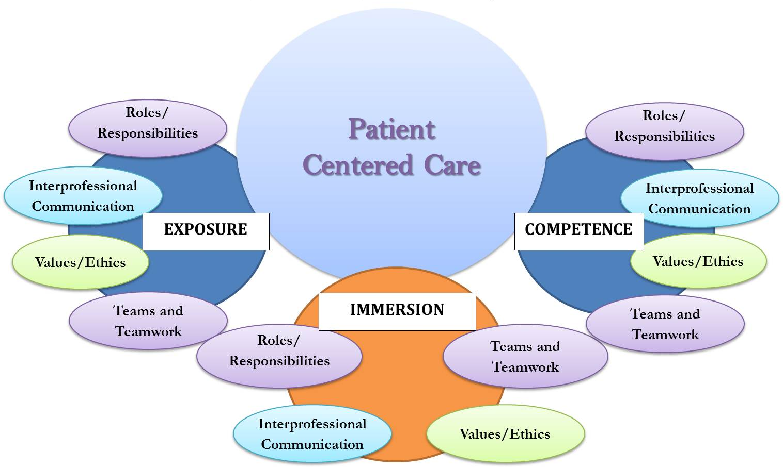

Slide 30
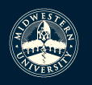
Integrating and Assessing the New CAPTE Interprofessional Education Standards in the Clinic
The Value of Incorporating the Core Competencies to Promote Clinical Excellence
with Clinical Partners
ELC 2016
Robert W. Nithman, PT,DPT,PhD(c),GCS,COS-C
Associate Professor, Midwestern University DPT Program
Glendale, Arizona
bnithman@midwestern.edu
I do not have any relevant financial or non-financial relationships to disclose.
National Interprofessional Education Consortium

Slide 31
Healthcare Statistics
1 in 8 Medicare patients readmitted within 30 days of being release after surgery (RWJF)
1 in 6 Medicare patients returned to a hospital within 1 month of leaving the hospital after receiving medical care (RWJF)
~30% of patients older than 70 years and hospitalized for a medical illness are discharged with an ADL disability they did not have before becoming acutely ill (Covinsky et al)
National Interprofessional Education Consortium

Slide 32
Healthcare Statistics
~50% of adults 85+ y/o will leave the hospital with a major new ADL disability (Covinsky et al)
US Healthcare system is the most costly in the world
  Proportion of GDP projected to increase from 17% to 20% by 2020 (CMS, IHI)
National Interprofessional Education Consortium

Slide 33
Clinical “Excellence” & IPCP
Excellence:
  Consistently using current knowledge and theory while understanding personal limits, integrating judgment and the patient/client perspective, embracing advancement, challenging mediocrity, and working towards the development of new knowledge. (APTA)
National Interprofessional Education Consortium

Slide 34
Clinical “Excellence” & IPCP
Quality
  The degree to which health care services for individuals and populations increase the likelihood of desired health outcomes and are consistent with current professional knowledge. (IOM)
  Excellence ←→ Quality
  VALUE = Quality ÷ Cost
National Interprofessional Education Consortium

Slide 35
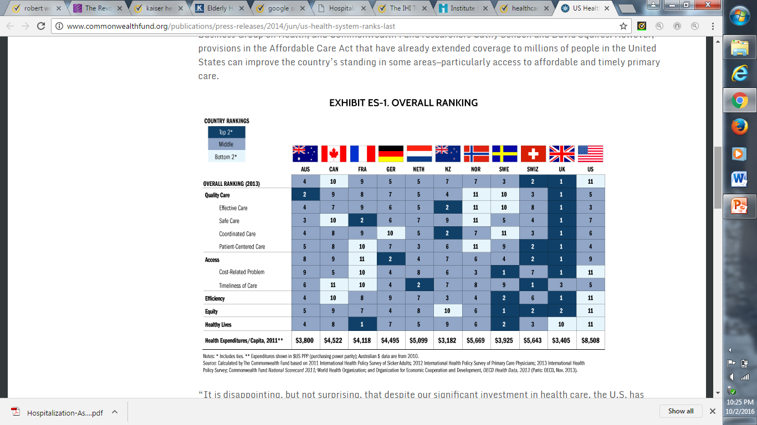
National Interprofessional Education Consortium

Slide 36
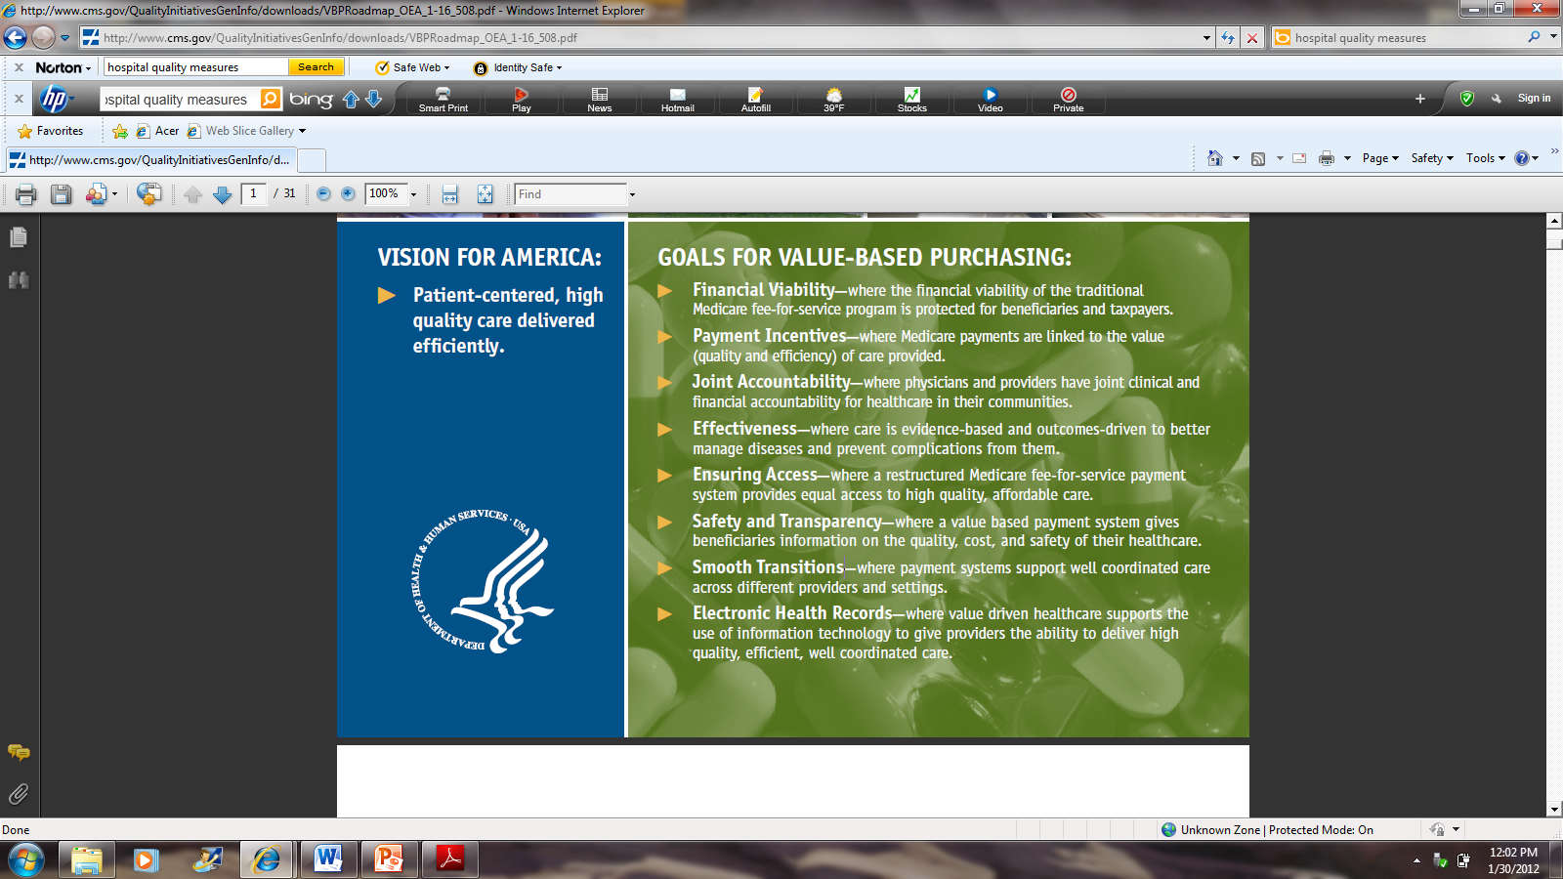
CMS.Gov

Slide 37
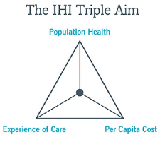
How do we sell “Value”?
Big Picture Strategies
  Population Health
  Organizational Outcomes
  Paradigm changes
  APTA Core Values
  Triple Aim Framework
  Partner with others leading change (IPEC, NAP, etc.)
“Collaborative practice” starts in the educational program but must also extend into the clinic…
Make the case that not working collaboratively affects the patient!
National Interprofessional Education Consortium

Slide 38
IPEC Core Competencies → Clinical Outcomes
CMS Initiatives that talk our language!
OBQI
Bundled care
Prospective Payment Systems
Publically Reported Outcome Data
Pay-for-Performance
National Interprofessional Education Consortium

Slide 39
IPEC Core Competencies → Clinical Outcomes
CMS Programs that talk our language!
Shared Savings Programs
  Accountable Care Organizations (ACOs), for ex.
Comprehensive Care for Joint Replacement Model (CJR)
National Interprofessional Education Consortium

Slide 40

Are WE Prepared?
How well prepared are we from the education side to communicate with the clinical side?
  Do we understand their challenges?
Are we prepared to be a content and change resource for our clinical partners?
  Help them to “sell” IPE opportunities to their administrators, colleagues in other departments
National Interprofessional Education Consortium

Slide 41
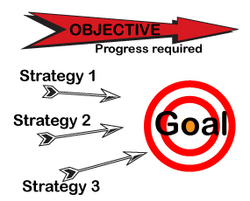
Strategies to Prepare Students and Clinical Faculty for Integration of IPE and IPP
National Interprofessional Education Consortium

Slide 42

Background
Rationale
Assessment of Institutional Readiness
Faculty and CI Development
Common Language
IP learning experiences
Assessment Resources
NIPEC’s IPE Activity/Project Summary Sheet
National Interprofessional Education Consortium

Slide 43
Background
To engage in meaningful interprofessional opportunities in clinical education and practice, students need a solid IPE foundation established during the didactic portion of their education.
Transferable SKILLS in collaborative practice
Purposeful learning with assessment
Variety of experiences
(Joseph 2013, Christopherson 2015, Freeth 2005, Bluteau 2009)
National Interprofessional Education Consortium

Slide 44
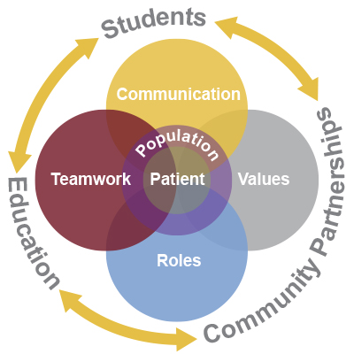
Rationale
Figure 1. Armstrong State University, Interprofessional Health Professions Collaboration. www.armstring.edu/health-professions/interprofessional-health-professions-collaboration. Accessed 9.1.2016
National Interprofessional Education Consortium
Notes:
Community partnerships should include all patient care settings…
IPE is a CAPTE requirement for accreditation, but also a key tool in maintaining best practice for patients and for population health.
Refer to Bob’s stats here

Slide 45

Assessment of Institutional Readiness
Create an Institutional Culture of Inter-professionalism
Buy-In from Key Stakeholders
Interprofessional Education Assessment and Planning Instrument for Academic Institutions
National Interprofessional Education Consortium

Slide 46

National Interprofessional Education Consortium

Slide 47

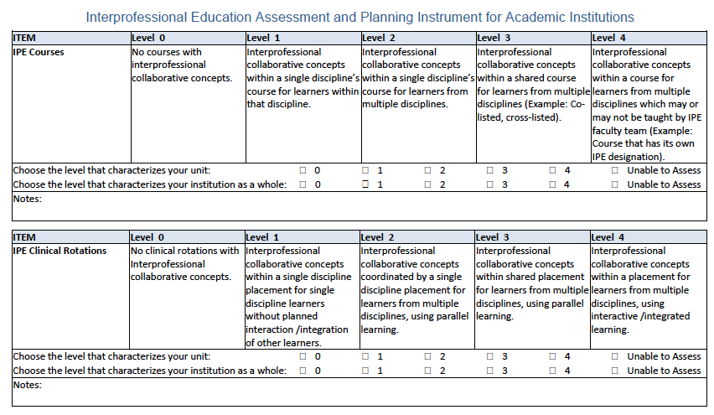
National Interprofessional Education Consortium

Slide 48
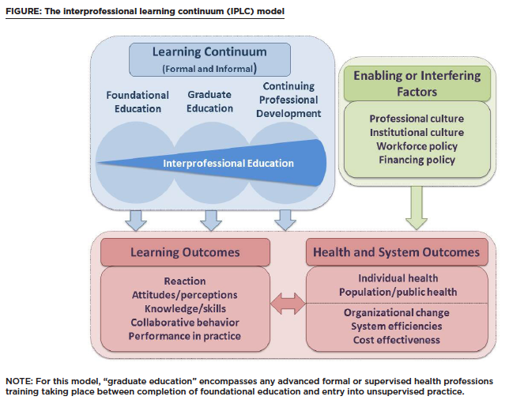
Figure 2- The interprofessional learning continuum (IPLC) model. Institute of Medicine. Measuring the Impact of Interprofessional Education on Collaborative Practice and Patient Outcomes. Washington, DC: The National Academies Press, 2015. doi:10.17226/21726.
National Interprofessional Education Consortium
Notes:
2015 report from committee convened by IOM methods needed to measure impact of IPE on coll practice and health and systems outcomes. Determined that to link IPL with person or population directed outcomes need 4 areas to lat a strong foundation for evaluating impact 1) more closely aligning edu and health care delivery systems, 2)dev conceptual framework for measuring impact of IPE 3) strengthen evidence base for IPE, 4) more effectively linking IPE with changes in collb behavior.(Kirkpatrik model) Committee put forth this conceptual model for eval of IPE in the setting where it is applied.

Slide 49
Are Clinical Faculty Prepared to Model IPC?
‘ACA is moving toward a team-based system… academic institutions challenged to find sufficient clinical experiences for students in community based practices that serve as models of team based care needed for contemporary practice.’
‘An alliance of education and practice will only be successful if the health care workforce is appropriately prepared for collaborative work… this is a shared responsibility between educational institutions and health care delivery systems.’
1) Advisory Committee on Interdisciplinary, Community-Based Linkages (ACICBL). Transforming Interprofessional Health Education and Practice: Moving Learners from the Campus to the Community to Improve Population Health. 13th Annual report to the Secretary of the US Department of Health and Human Services and the Congress of the US. October 2014.
2) Josiah Macy Foundation. Transforming Patient Care: Aligning Interprofessional Education with Clinical Practice Redesign. Conference Recommendations. January 2013. Atlanta, GA.
National Interprofessional Education Consortium

Slide 50

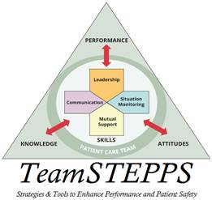

Faculty and CI Development
Updates to Credentialed
Clinical Instructor Program (CCIP)?
CE Courses
  TeamSTEPPS Master Trainers
  Academic Programs with IPE
  NEXUS Learning System
  AIHC Interprofessional Webinar Series
  AAMCs MedEdPORTAL CE Directory
  General CE Programs
Faculty Development Tools
  U Washington Faculty Training Toolkit
  U Minnesota Academic Health Center Office of Education
  U Kansas Center for Interprofessional Education
National Interprofessional Education Consortium
Notes:
AAMC’s MedEdPortal launched in 2012 has 28 fully developed modules directly linked to IPEC competencies. May be especially useful for regional campuses without other disciplines on same campus. Modules range from case-based resources, evaluation tools, abd nultimedia resources, to presentations, lab guides, references and tutorials. Principal topics=comm skills, curriculum dev or evaluation, health edu, and eal of clinical performance.

Slide 51

American Interprofessional Health Collaborative
U.S. Interprofessional Education Programs
Western University of the Health Sciences
Virginia Commonwealth University
Texas Tech University Health Sciences Center
Jefferson Interprofessional Education Center, Thomas Jefferson University
Center for Healthcare Improvement and Patient Safety, Perelman School of Medicine, University of Pennsylvania
Oregon Health & Science University
C3, Creating Collaborative Care, Medical University of South Carolina
University of Virginia
REACH: University of Colorado Denver, Anschutz Medical Campus
IPE Pitt: University of Pittsburgh
Department of Bioethics and Interdisciplinary Studies, East Carolina University
Office of Interprofessional Education, Creighton University Medical Center
InterProfessional Education Collaborative, University of New England
Center for Health Science Interprofessional Education, Research & Practice, University of Washington
University of Texas Medical Branch
University of New Mexico
University of Nebraska
Vanderbilt University
Grand Valley State University
St Louis University
University of Kentucky
University of Minnesota
Rosalind Franklin University
University of Arizona
University of Florida
University of Connecticut
National Interprofessional Education Consortium

Slide 52



Faculty and CI Development
Workshops
  IPEC Conferences
  T3 Train the Trainer
  University of Toronto Center
  for Interprofessional Education
Conferences
  All Together Better Health (ATBH)
  Collaborating Across Borders (CAB)
  Interprofessional Health, Education and Practice International Conference (IHEP)
  Learning Together at the NEXUS Summit
National Interprofessional Education Consortium

Slide 53
Faculty and CI Development
IPECP Organizations
  National Center for Interprofessional Practice and Education (NEXUS)
  National Academies of Practice (NAP)
  Interprofessional Education Collaborative (IPEC)
  American Interprofessional Health Collaborative (AIHC)
  Institute for Healthcare Improvement (IHI)
  Center for the Advancement of Interprofessional Education (CAIPE)
  European Interprofessional Practice and Education network (EIPEN)
  Canadian Interprofessional Health Collaborative (CIHC)
  Australasian Interprofessional Practice and Education Network (AIPPEN)
  Transforming Interprofessional Groups through Educational Resources (TIGER)
  Nordic Interprofessional Network (NIPNET)
See NIPEC page for hyperlinks!
National Interprofessional Education Consortium
Notes:
http://caipe.org.uk/resources/ipe-links/
http://collaborate.uw.edu/resources-and-publications/ipe-resources/national-and-international-ipe-organizations.html
TIGER has great IPE planning toolkits as well as comprehensive student tracking document.

Slide 54

Common Language
IPEC core competencies
The Joint Commission’s do not use list of abbreviations
International Classification of Functioning Disability and Health (ICF) (Ankam 2013)
Bloom’s Taxonomy in Action Online Resoure
National Interprofessional Education Consortium

Slide 55

Interprofessional Learning Experiences
Find a partner!
Variety of levels both early and late in curriculum
Thread through programs
National Interprofessional Education Consortium

Slide 56
IP Wound Care Case
Learner Objectives
  Explore common curriculum and individual areas of expertise (IPEC: RR1, RR2, RR3, RR6, RR9, CC4, TT4, TT8; CAPTE: 6 F, 7 D28)
Exercise
  Students from nursing, physical therapy, and pharmacy work together in assigned teams to discuss a complex case where wound care is the patient’s primary priority
Assessment
  Small and large group debrief, team SOAP note
National Interprofessional Education Consortium

Slide 57
IP Wound Care Case
IPEC:
  RR1 Communicate one’s roles and responsibilities clearly to patients, families, community members, and other professionals.
  RR2 Recognize one’s limitations in skills, knowledge, and abilities
  RR3 Engage diverse professionals who complement one’s own professional expertise, as well as associated resources, to develop strategies to meet specific health and healthcare needs of patients and populations.
  RR6 Communicate with team members to clarify each member’s responsibility in executing components of a treatment plan or public health intervention
  RR9 Use unique and complementary abilities of all members of the team to optimize health and patient care.
  CC4 Listen actively, and encourage ideas and opinions of other team members
  TT4 Integrate the knowledge and experience of health and other professions to inform health and care decisions, while respecting patient and community values and priorities/preferences for care
  TT8 Reflect on individual and team performance for individual, as well as team, performance improvement.
CAPTE:
  6 F The didactic and clinical curriculum includes interprofessional education; learning activities are directed toward the development of interprofessional competencies including, but not limited to, values/ethics, communication, professional roles and responsibilities, and teamwork.
  7 D28 Management of Care Delivery. Manage the delivery of the plan of care that is consistent with professional obligations, interprofessional collaborations, and administrative policies and procedures of the practice environment
National Interprofessional Education Consortium

Slide 58
Phone a Physician
Learner Objectives
  Succinctly and professionally communicate a patient case and call to action with someone in a decision-making role (IPEC: CC1, CC2, CC3, CC7; CAPTE: 6 F, 7 D7)
Exercise
  Student use ISBAR to communicate a patient issue to a “primary care provider”.
  Call faculty member to briefly summarize patient concern and come to resolution, or mutually agreed plan of action
Assessment
  Faculty rate student interaction on 5 point likert scale
National Interprofessional Education Consortium

Slide 59
Phone a Physician
IPEC:
  CC1 Choose effective communication tools and techniques, including information systems and communication technologies, to facilitate discussions and interactions that enhance team function.
  CC2 Communicate information with patients, families, community members and health team members in a form that is understandable, avoiding discipline-specific terminology when possible.
  CC3 Express one’s knowledge and opinions to team members involved in patient care and population health improvement with confidence, clarity, and respect, working to ensure common understanding of information and treatment and care decisions, and population health programs and policies.
  CC7 Recognize how one’s own uniqueness, including experience level, expertise, culture, power, and hierarchy within the health team, contributes to effective communication, conflict resolution, and positive interprofessional working relationships (University of Toronto, 2008).
CAPTE
  6 F The didactic and clinical curriculum includes interprofessional education; learning activities are directed toward the development of interprofessional competencies including, but not limited to, values/ethics, communication, professional roles and responsibilities, and teamwork.
  7 D7 Professional Ethics, Values and Responsibilities. Communicate effectively with all stakeholders, including patients/clients, family members, caregivers, practitioners, interprofessional team members, consumers, payers, and policymakers
National Interprofessional Education Consortium

Slide 60
Senior Day
Learner Objectives
  Screen community senior volunteers and develop an integrated health report summary and recommendations (IPEC: RR1, RR3, RR6, CC2, CC3, CC4, TT4, TT7, VE1, VE2, VE3, VE4; CAPTE: 6 F, 6 L3, 7 D7)
Exercise
  PT, SLP, Nutrition, Pharmacy and Nursing students perform discipline specific screens in assigned teams with volunteer at beginning of semester, then work together to develop a summary and plan of care for the volunteer and review their findings and recommendations with volunteer during a follow up session at the end of the semester.
Assessment
  Volunteer Feedback Form, Self Assessment, Team Assessment
National Interprofessional Education Consortium

Slide 61
Senior Day
IPEC:
  RR1 Communicate one’s roles and responsibilities clearly to patients, families, community members, and other professionals.
  RR3 Engage diverse professionals who complement one’s own professional expertise, as well as associated resources, to develop strategies to meet specific health and healthcare needs of patients and populations.
  RR6 Communicate with team members to clarify each member’s responsibility in executing components of a treatment plan or public health intervention.
  CC2 Communicate information with patients, families, community members and health team members in a form that is understandable, avoiding discipline-specific terminology when possible.
  CC3 Express one’s knowledge and opinions to team members involved in patient care and population health improvement with confidence, clarity, and respect, working to ensure common understanding of information and treatment and care decisions, and population health programs and policies.
  CC4 Listen actively, and encourage ideas and opinions of other team members.
  TT4 Integrate the knowledge and experience of other professions—appropriate to the specific care situation—to inform care decisions, while respecting patient and community values and priorities/preferences for care.
  TT7 Share accountability with other professions, patients, and communities for outcomes relevant to prevention and health care.
  VE1 Place the interests of patients and populations at the center of interprofessional health care delivery and population health programs and policies, with the goal of promoting health and health equity across the life span.
  VE2 Respect the dignity and privacy of patients while maintaining confidentiality in the delivery of team-based care.
  VE3 Embrace the cultural diversity and individual differences that characterize patients, populations, and the health team.
  VE4 Respect the unique cultures, values, roles/responsibilities, and expertise of other health professions and the impact these factors can have on health outcomes.
CAPTE:
  6 F The didactic and clinical curriculum includes interprofessional education; learning activities are directed toward the development of interprofessional competencies including, but not limited to, values/ethics, communication, professional roles and responsibilities, and teamwork.
  6 L3 Involvement in interprofessional practice
  7 D7 Professional Ethics, Values and Responsibilities. Communicate effectively with all stakeholders, including patients/clients, family members, caregivers, practitioners, interprofessional team members, consumers, payers, and policymakers
National Interprofessional Education Consortium

Slide 62
Leadership in Health Professions
Learner Objectives
  Describe importance of interprofessional teams; acquire and demonstrate team-building and leadership skills; Effectively communicate with colleagues from all health professions; Give constructive feedback; Work effectively in an interprofessional team (ALL IPEC competencies and CAPTE IPE criteria)
Exercise
  Semester long course with various experiences, including: professional shadowing, standardized patient and simulation scenarios, case discussions, small and large group discussions. Course culminates in a case-based team capstone project.
Assessment
  IPAS and/or IPEC Competency Survey, evaluation of capstone.
National Interprofessional Education Consortium

Slide 63
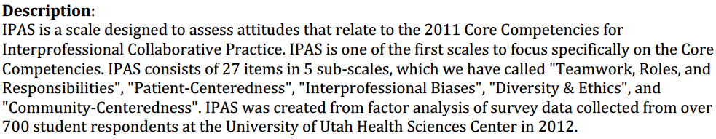
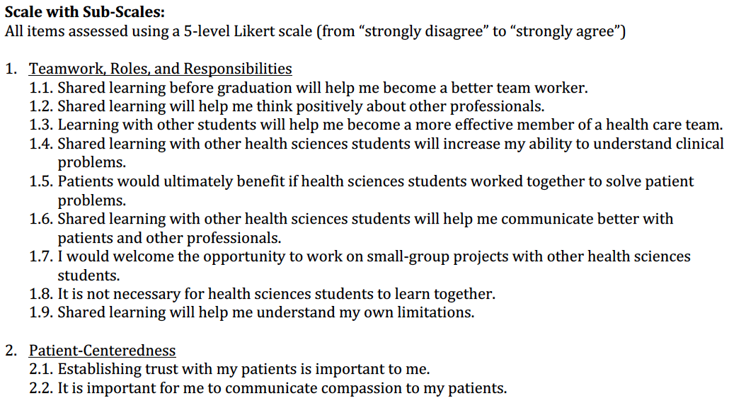
National Interprofessional Education Consortium

Slide 64
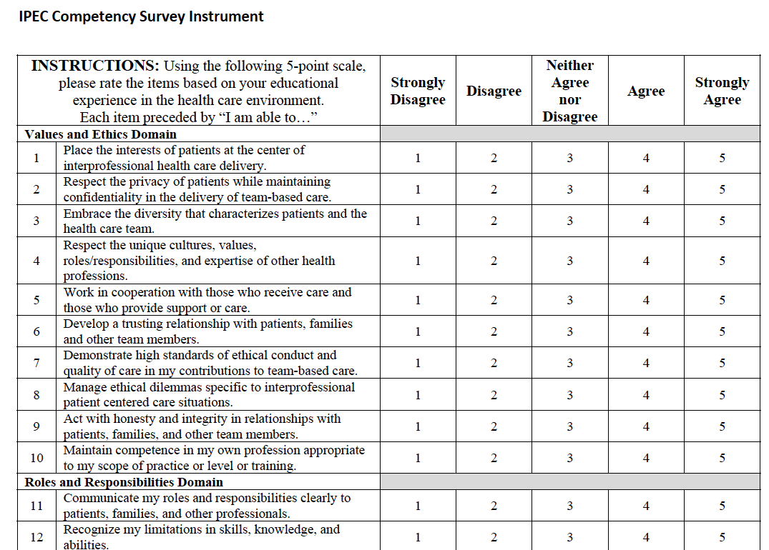
National Interprofessional Education Consortium
Notes:
Assesses each of the 4 competencies and sub-competencies

Slide 65
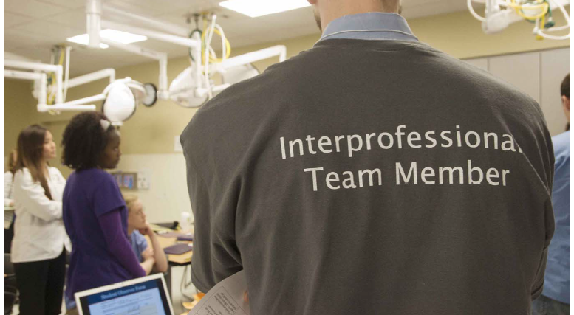
IPE Day
National Interprofessional Education Consortium

Slide 66
IPE Day
Learner Objectives
  Articulate team members’ roles and responsibilities. Collaborate effectively in an interprofessional team and identify domestic violence through standardized patient interview
Exercise
  Half day IPE event with 450+ students from 3 different institutions and 6 different health programs. Divided into 3 activities: standardized patient interview, complicated patient case, and team building activity
Assessment
  SPICE-R, RIPLS, Modified McMaster-Ottawa Individual Rating Scale, ICAR
National Interprofessional Education Consortium

Slide 67
Student Perceptions of Interprofessional Clinically (based) Education – Revised (SPICE-R)
Instructions: Please indicate the extent of your agreement with each of the following statements related to interprofessional teams and the team approach to care. It is very important that you be candid in your responses.
Rating Scale: Five – point Likert-Type Scale
Strongly Disagree = 1, Disagree = 2, Neutral = 3, Agree = 4, Strongly Agree = 5
Working with students from another health profession enhances my education.
My role within an interprofessional healthcare team is clearly defined.
Health outcomes are improved when patients are treated by a team that consists of individuals from two or more health professions.
Patient satisfaction is improved when patients are treated by a team that consists of individuals from two or more health professions.
Participating in educational experiences with students from another health profession enhances my future ability to work on an interprofessional team.
All health professional students should be educated to establish collaborative relationships with members of other health professions.
I understand the roles of other health professionals within an interprofessional team.
Clinical rotations are the ideal place within their respective curricula for health professional students to interact.
Health professionals should collaborate on interprofessional teams.
During their education, health professional students should be involved in teamwork with students from other health professions in order to understand their respective roles.
National Interprofessional Education Consortium

Slide 68
Readiness for Interprofessional Learning Scale (RIPLS)
5 point Likert-Type Scale (Strongly agree, Agree, Undecided, Disagree, Strongly Disagree)
- Learning with other students/professionals will make me a more effective member of a health and social care team
- Patients would ultimately benefit if health and social care students/professionals worked together
- Shared learning with other health and social care students/professionals will increase my ability to understand
clinical problems
- Communication skills should be learned with other health and social care students/professionals
- Team-working skills are vital for all health and social care students/professionals to learn
- Shared learning will help me to understand my own professional limitations
- Learning between health and social care students before qualification and for professionals after qualification would
improve working relationships after qualification/collaborative practice
- Shared learning will help me think positively about other health and social care professionals
- For small group learning to work, students/professionals need to respect and trust each other
- I don’t want to waste time learning with other health and social care students/professionals
- It is not necessary for undergraduate/postgraduate health and social care students/professionals to learn together
- Clinical problem solving can only be learnt effectively with students/professionals from my own school/organisation
- Shared learning with other health and social care professionals will help me to communicate better with patients
and other professionals
- I would welcome the opportunity to work on small group projects with other health and social care students
professions
- I would welcome the opportunity to share some generic lectures, tutorials or workshops with other health and
social care students/professionals
- Shared learning before and after qualification will help me become a better team worker
- I am not sure what my professional role will be/is
- I have to acquire much more knowledge and skill than other students/professionals in my own faculty/organisation
National Interprofessional Education Consortium

Slide 69
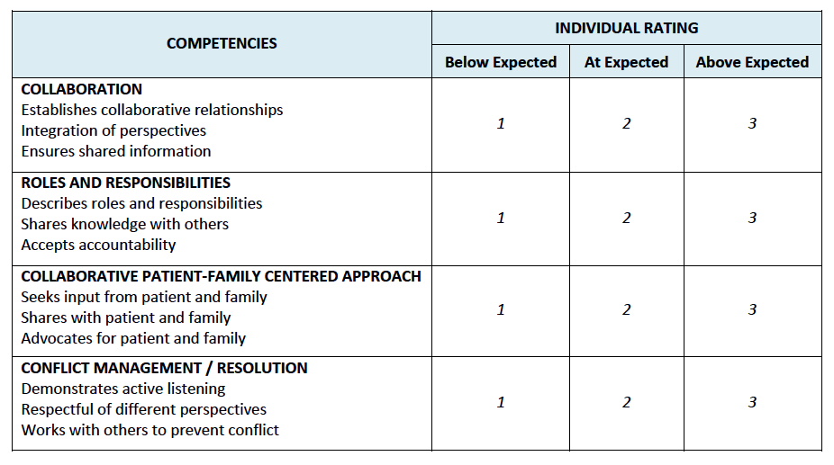
Modified McMaster-Ottawa: Individual Rating Scale
National Interprofessional Education Consortium

Slide 70
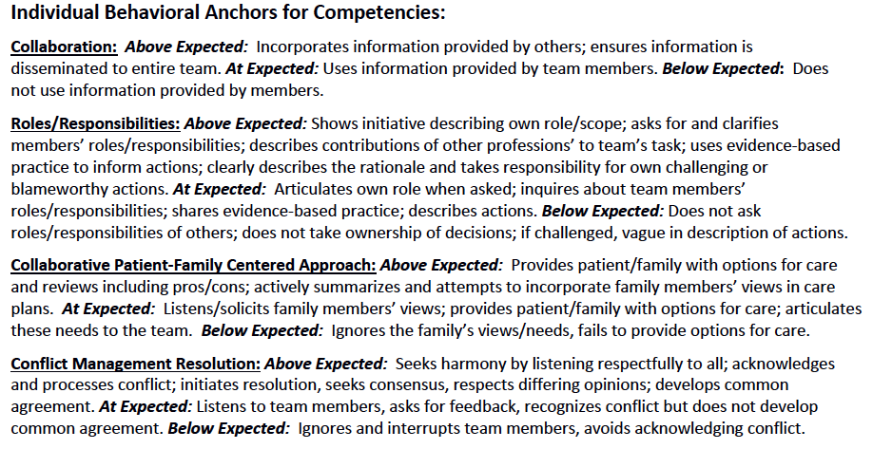
Modified McMaster-Ottawa: Individual Rating Scale
National Interprofessional Education Consortium

Slide 71
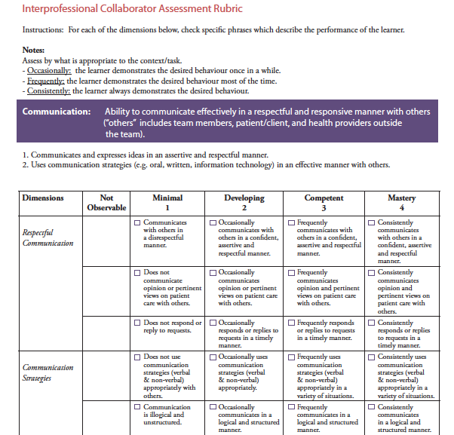
Interprofessional Collaborator Assessment Rubric
National Interprofessional Education Consortium
Notes:
Curran V, Hollett A, Casimiro LM, Mccarthy P, Banfield V, et al. Development and validation of the interprofessional collaborator assessment rubric (ICAR). J Interprof Care. 2011 Sept;25(5):339-44. https://www.ncbi.nlm.nih.gov/pubmed/21732723

Slide 72
Assessment Tool Resources
NEXUS Assessment and Evaluation
CIHC Inventory of Quantitative Tools to Measure IPE
CIHC Program Evaluation for Interprofessional Initiatives
Assessing Health Care Team Performance: A Review of Tools and the Evidence Supporting Their Use
Thomas Jefferson University: Assessment Tools for IPE, Learning, & Practice
University of Washington: Assessment and Evaluation
MUSC Interprofessional Practice, Education, and Team Science: Measurement Tools
W(e) Learn Framework: IPE Assessment Instruments
MedEdPORTAL
New tools being developed
Macy Foundation: Innovative Tools for Ealuating Interprofessional Competencies
Innovative Tools for Assessing Interprofessional Competencies
Performance Assessment of Communication & Teamwork (PACT) Tool Set
Interprofessional Professionalism Assessment (IPA) Instrument
National Interprofessional Education Consortium
Notes:
http://www.cihc.ca/files/CIHC_EvalMethods_Final.pdf
http://www.cihc.ca/evaluation/framework/index.php?%20Pid=368
https://www.med.mun.ca/getdoc/b78eb859-6c13-4f2f-9712-f50f1c67c863/ICAR.aspx
http://musc.libguides.com/interprofessional/measurement
http://rcrc.brandeis.edu/pdfs/Canadian%20Interprofessional%20Health%20Collaborative%20report.pdf
http://www.aippen.net/criehassessment
http://tiger.library.dmu.ac.uk/Example%20Portfolio%20for%20students%20at%20Leicester-Northants-Demontfort%20Unis.pdf

Slide 73
NIPEC IPE Activities or Projects Summary
Name of Institution
Date
Author/Reporter (please provide contact information in addition to your name)
1. Title of Activity (If IPE experience is embedded in a course(s), please provide a link to the course and a contact name)
2. Purpose/Rationale for activity
3. Target participants
  a. List all other disciplines included_____________________________________________
4. Collaborative partner(s) – Institutions, departments, divisions, etc.
5. History of development/important background information
6. Specific activity/project (brief)
7. Teaching methodology (check all that apply)
  a. Didactic
  b. Simulation
  c. Clinical education
8. Participation
  a. Required
  b. Service learning
  c. Research
9. Outcome(s) assessed, tools utilized (please provide citation if possible)
10. Lessons learned, challenges
11. Future plans
12. Needs/Resources
13. Strategies for success, considerations for implementation
14. References
National Interprofessional Education Consortium

Slide 74
IP Wound Care Case – Activity Summary
Name of Institution: University of Rhode Island
Date: September 27th 2014
Author: Samantha Brown skbrownPT@gmail.com 914-764-1408
1) Title of Activity: Interprofessional Wound Care Workshop (part of Spring PHT 592 Comprehensive Cases)
2) Purpose: Allow students in different health disciplines to work as a team to assess a complicated case scenario involving a patient with a wound and reflect on the experience working as a team and what other resources/team members might have been indicated.
3) Target audience: Students from 3 health care programs -- Physical Therapy (3rd year), Nursing (4th year) and Pharmacy (5th year)
4) Collaborative partner(s): University of Rhode Island’s Physical Therapy Department and the Colleges of Pharmacy and Nursing
5) History of development/important background information: This workshop was piloted Spring 2014 and hosted in the PT Department. Rationale for activity/project: Allowing students from different health disciplines to work together to assess the needs of a case based patient and discuss how one another’s intervention might affect/support the other’s intervention/treatment. Develop awareness of the scope of practice and expertise associated with each discipline and how a patient’s plan of care/outcome may be enhanced through collaboration.
6) Specific activity/project (brief): Students from PT, PharmD, and Nursing are assigned into teams of 4 or 5 students and given a complex case scenario and photograph of a wound with question prompts throughout to move teams through the case and into a group reflection and SOAP note. The lab is concluded with a large format debrief and discussion of case and role of the team.
7) Teaching Methodology: Didactic
8) Participation: required for all 3rd year DPT students, required for specific lab sections in PharmD and Nursing
9) Outcome(s): Positive student feedback, SOAP note. Would utilize SPICE-R and/or IPAS
10) Lessons learned: Students need to sit next to someone from a different discipline or teams should include only one student from each discipline to keep discussion between professionals robust. The emphasis is not on the actual student prescriptions for the case, but the reflection on the value of consulting other disciplines.
11) Future plans: Continue the lab as able; perhaps add a skills component, such as treating/dressing a wound (simulation)- etc. Modify team composition or seating arrangement. Include a prelab survey and brief online learning module.
12) Resources: Space, wound dressings, books and literature for in-class reference and modalities for demonstration
13) Strategies for success, considerations for implementation: Because professional buildings are spread out, need to consider allowing extra time for students to get to and from learning activity. All faculty should review case and discuss best practices to be able to facilitate groups effectively (perhaps create a faculty reference sheet).
14) References: Case was adapted from Bruyere, HJ (2009). Case studies in pathophysiology. New York: Wolters Kluwer/ Lippincott, Williams & Wilkins
National Interprofessional Education Consortium

Slide 75
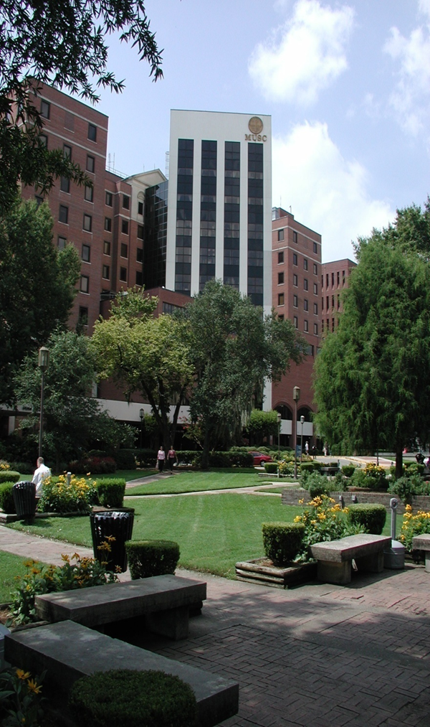
Interprofessional Activities for Student Use in the Clinic
National Interprofessional Education Consortium

Slide 76

Caregivers Are Heroes
MUSC College of Health Professions IP Collaborative Faculty:
Holly Wise, PT, PhD, Nancy Carson, PhD, OTR/L and Paul Jacques, DHSc, PA
Publication accepted Journal of Allied Health
First semester students:
Physical therapy (PT)
Occupational therapy (OT)
Physician assistant studies (PA)
Community Partners
Trident Area Agency on Aging
Hands of Hope
Care Partners, Parkinson’s Support Group
National Interprofessional Education Consortium
Notes:
Family Centered Care!!! Author Vining Davis Foundation

Slide 77

Caregivers Are Heroes
Overarching Goal: Provide students with knowledge and skills to be caring professionals; to create healing, humanistic healthcare environments where patients are respected and receive patient-centered quality care
Keys to success:
Administrative & Faculty
Common time carved out in all 3 programs
Learning objectives (meet accreditation criteria) embedded in all 3 programs
Assignments, faculty shifting/sharing of course responsibilities, etc.
National Interprofessional Education Consortium
Notes:
SUSTAINABLE 8 years and going strong!
Caregiver Interview chosen because perspective taking enhances development of empathy and compassion. Three large group sessions to introduce the community partners, explain narratives and information protection and communication.

Slide 78
How it works
Chart Talk:
Students prepared for interview session
Conducted interview and took notes
Each student completed a SOAP note of interview with caregiver
Art Talk:
Each caregiver interview group paired with two other groups to form a team
Discussed what they learned about caregivers
Created an artistic representation of what they learned
Shared with larger group consisting of 5-6 teams
National Interprofessional Education Consortium
Notes:
There is NO faculty member present during the interviews.
The tri-team group of about 10 students are required to collaborate and develop a presentation using a form of humanities to express the essence of the interaction. Because all 3 community organizations were involved, provides students with opportunity to reflecy, discuss and learn about the other caregivers from the other students’ p[erspectives.

Slide 79
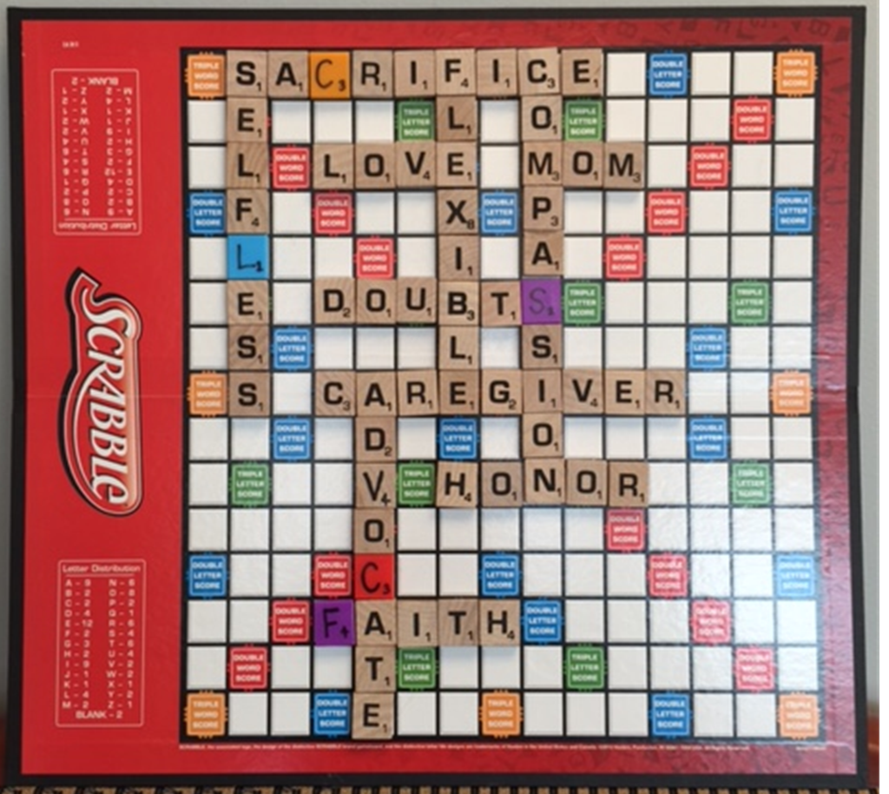
National Interprofessional Education Consortium
Notes:
"Caregivers are Heroes: An innovative educational strategy designed to promote compassion/caring in health professional students," has been accepted for publication in the Journal of Allied Health.

Slide 80
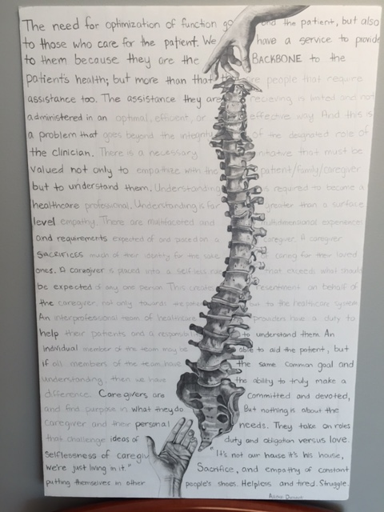
National Interprofessional Education Consortium

Slide 81
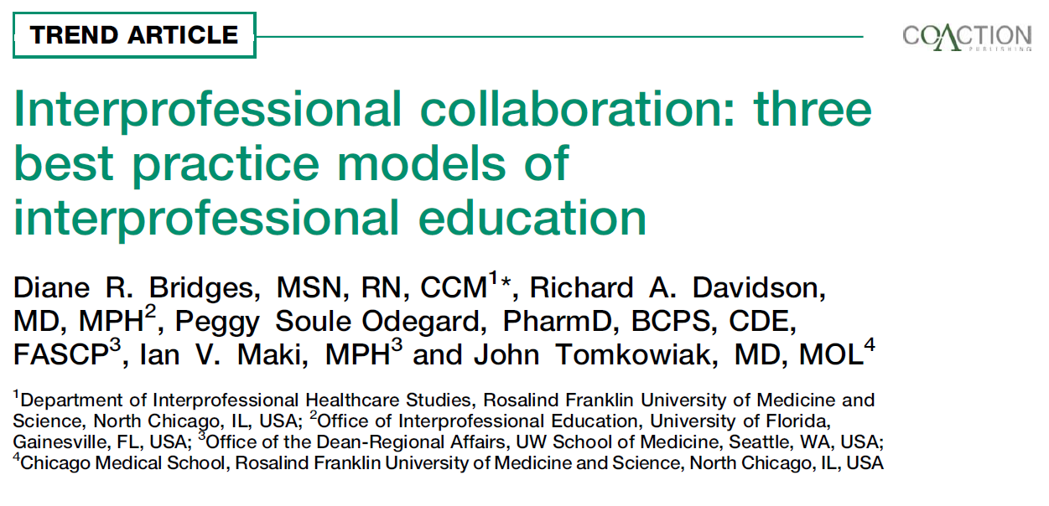
National Interprofessional Education Consortium
Notes:
Dr Davidson Retires Dec 2013. Lots of different versions and formats. Case studies explore a variety of episodic and complex health challenges from an individual, family and community perspective, cultivating an understanding of interprofessional practice

Slide 82
University of Florida
Interdisciplinary Family Health (IFH) provides IP Community-based learning experiences which are embedded in required IP Course, four home visits over two semesters.
Course goals are primarily to demonstrate impact of environment and resources on health status and emphasize the importance of IP collaborative effort in providing services to patients.
Assignments vary by visit – early visits include:
    family genogram
    windshield survey of neighborhood (access to grocery store, drug store, safety, etc)
    extensive health survey
National Interprofessional Education Consortium
Notes:
Add population health

Slide 83
University of Florida
After these early visits, student teams develop a project to address the family health status.
Subsequent visits include:
  Team meets with social work provides assistance with the project
  Presentation of project to family
  Final visit to determine effectiveness of project or acceptability from family perspective
  Teams submit family projects (powerpoint, video, etc) and individual students write a reflection paper addressing the impact on their development as a health professional.
National Interprofessional Education Consortium
Notes:
Supervising faculty are from many disciplines and rarely meet the family- as project is NOT providing medical care to these families, although students may arrange for medical services.

Slide 84

Online Synchronous Case Conferences
Online, synchronous conference activity
that brings students from remote sites together for patient case discussions
Online due to the difficulty of bringing students on clinical practicums across the country together to meet in person, allows students to complete the same interprofessional activity synchronously online.
Pharmacy, PA, OT, PT and Nursing students
National Interprofessional Education Consortium
Notes:
Talk about barriers, time. Space, manpower, money

Slide 85

Online Synchronous Case Conferences
Series of meetings over 2 months
Small groups of ~4 students and 1-2 faculty facilitators meet online (using Webex)
PowerPoint is utilized to discuss the patient case and the role of their particular profession within the team
Initial discussion utilizes a pre-established trauma case which included most healthcare providers for role awareness
National Interprofessional Education Consortium

Slide 86
Online Synchronous Case Conferences
  Subsequent sessions involve each student presenting a case from their actual acute IP practicum.
  Focus on how to best care for the patient (professional roles).
  Recommended headings included:
  Patient demographics (de-identified)
  Chief complaint
  History of present illness
  Review of systems
  Diagnosis
  Problem list
  Plan of care during hospitalization
  Health care providers involved in this patient’s care

Slide 87
Online Synchronous Case Conferences
Students see applicability of this experience to future community engaged educational experiences.
Enjoyable aspects
  Excitement of participating and eagerness to learn
  Hearing other student ideas/viewpoints on the cases
  Recognizing other professions’ scope of practice
  Learning more about what individuals can do to help patients by referring to other professions
  Efficiency/coordination of the activity
National Interprofessional Education Consortium

Slide 88
Online Synchronous Case Conferences
Facilitator feedback
  Overall, the sessions typically go well and all students ended up contributing
  Exciting way to promote interprofessional learning
  Satisfying to be a part of this experience and observe students having these type of interactions/experiences
  Student interaction can be slow to reach full engagement during 1st session but they usually warm up, especially when presenting their case
National Interprofessional Education Consortium

Slide 89
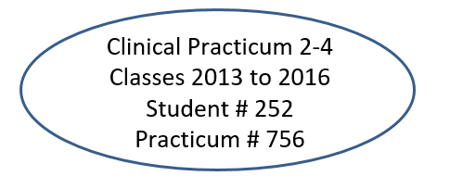
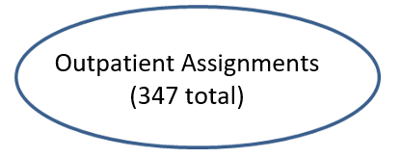
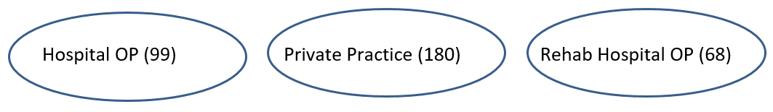
MUSC DPT Curriculum Fulltime Clinical Practicums
Clinical Practicum 1 (5th Semester) All Outpatient Orthopedics
Clinical Practicum 2, 3, 4 (8th and 9th Semesters) All areas of practice

Slide 90

Interprofessional Healthcare Delivery Activity Tracking Form (IPHDAT)
Online, Self-assessed form using RedCAP as a mechanism to collect information about IP occurrences (started with word form in 2008)
IPHDAT is used by the College of Health Profession students during full-time practicums.
Programs include:
  Anesthesia for Nurses
  Cardiovascular Perfusion
  Occupational Therapy
  Physician Assistant Studies
  Physical Therapy
National Interprofessional Education Consortium

Slide 91
Interprofessional Healthcare Delivery Activity Tracking Form (IPHDAT)
Gathers information including practicum settings:
  Acute Care
  Inpatient Rehabilitation
  Skilled Nursing Facility/Assisted Living Facility
  Outpatient Hospital
  Outpatient Private Practice
  Outpatient Rehabilitation Hospital
  Home Health
  School
  Mental Health
  Other __________
Types of ACTIVE collaboration including:
  Case conference
  D/C Planning Meeting
  Phone Call
  Other live meeting
  Electronic Communications
National Interprofessional Education Consortium

Slide 92
Interprofessional Healthcare Delivery Activity Tracking Form (IHPDAT)
Types of practitioners they actively collaborated with:
Audiology
Cardiovascular Perfusion
Dentistry
DME Consultant
Dietary
Education
Medicine (MD/PA)
Nursing
Occupational Therapy
Pharmacy
Physical Therapy
Prosthetics/Orthotics
Psychology
Recreational Therapy
Respiratory Therapy
Social Work
Speech Pathology
Vocational Rehabilitation
National Interprofessional Education Consortium

Slide 98
Interprofessional Healthcare Delivery Activity Tracking Form
Student instructions: Describe ……interprofessional team….. patient/ family included…
Hospital OP:
“In the clinic I am working in we have PT's, 1 PTA, 1 OT, 1 SLP and we all work alongside and with one another. This facility was part of a hospital so I communicated with cardiac doctors about patient problems and discharge decisions.”
“I was able to work closely with OT, speech pathologists, and PTA's, however, I did not feel that this location had enough patient load collaboration ingrained into this facilities standards. There were no formal meetings to talk about patients with OTs or PTA's. I had to reach out to other health professionals personally for patient care collaboration.”
National Interprofessional Education Consortium
Notes:
Student instructions: Describe …..Anonymous description of the patient i.e. during case conference , consulted with pharmacist re medications and side effects that may affect alertness of with a 25 yo female with TBI; no medication changes were made but will continue monitoring level of alertness for future needs

Slide 99
Interprofessional Healthcare Delivery Activity Tracking Form
Student instructions: Describe ……interprofessional team….. patient/ family included…
Private Practice:
“As a PT outpatient clinic….we remained in regular contact with patient's physicians and surgeons to coordinate progress and appropriate plan of care. All communication was done electronically, but provided quick, reliable communication with other health disciplines throughout the plan of care. “
“At our clinic we had 'global' visits in which the doctors who were right across the hall would come in for our patients 2, 6, or 12 week check-up at the end of our PT session to see how they are doing and to collaborate with PT as to what we still would want to see in treatment.”
National Interprofessional Education Consortium

Slide 100
Interprofessional Healthcare Delivery Activity Tracking Form
Student instructions: Describe …..Anonymous description of a patient case…
Hospital OP:
“16 year old patient recovering from ACL reconstruction. The MD requested hop testing be performed, but myself and my CI did not believe he was ready. We consulted with the MD through email stating our concerns for the patient's readiness for hop testing.”
“The attending physician and I discussed the mobility goals and potential seating options to allow more social interaction for an 18-month old male with respiratory complications, increased spasticity, and impaired head and trunk control. We concluded that his mother would benefit from written instructions for an exercise program and that my instructor and I would brainstorm possible seating options during his acute care stay.”
National Interprofessional Education Consortium

Slide 101
Interprofessional Healthcare Delivery Activity Tracking Form
Student instructions: Describe …..Anonymous description of the patient case
Private Practice:
“…we had a post-operative female with a meniscal tear...still having pain and not improving as expected. No treatment techniques were proving effective for pain relief; therefore, we contacted the surgeon for a follow-up and any possible necessary alternative treatment/imaging.”
“26 year old who is 6 weeks post-operative ACL. We have been in electronic communication with the patient's surgeon to progress plan of care and ensure appropriate activity and range of motion restrictions in order to protect the ligament repair.”
National Interprofessional Education Consortium

Slide 102
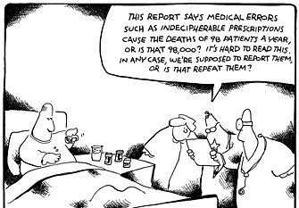
Assessing Interprofessional Opportunities and Skills
National Interprofessional Education Consortium

Slide 103
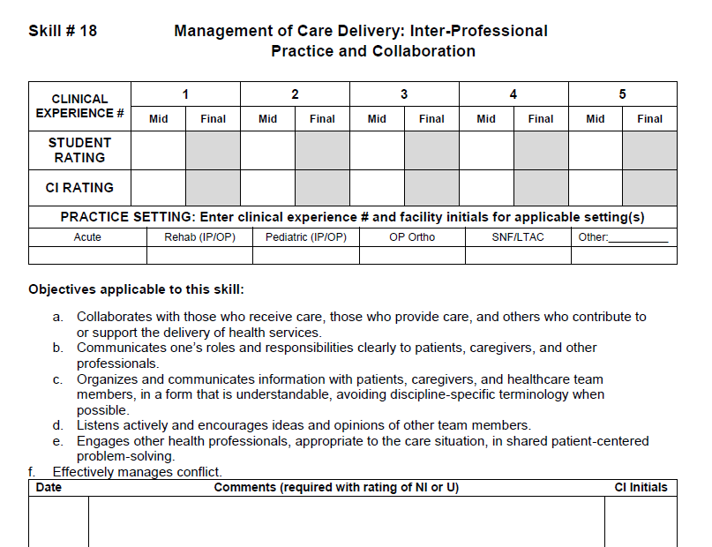
The Physical Therapist Manual for the Assessment of Clinical Skills (PT MACS)
National Interprofessional Education Consortium

Slide 104
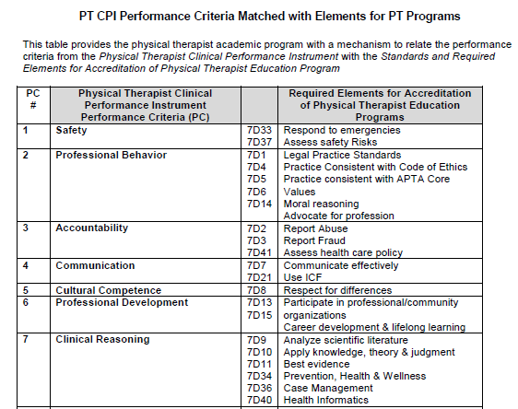
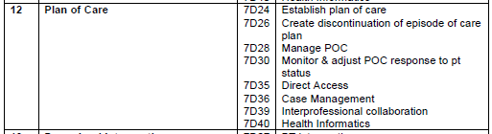

Slide 105
Clinical Performance Instrument (CPI)
The APTA Clinical Education Technology Work Group assists the APTA in prioritizing enhancements to the CPI on an annual basis.
Any substantive changes to the CPI may require that the instrument be validated again. The first version of the CPI was developed during a 3-year period and published for use with PT students in 1997. The CPI was later revised, field tested and approved by the APTA’s Board of Directors in November 2006.
We have been informed the APTA plans to survey the CPI and Clinical Site Information Form (CSIF) stakeholders regarding these products and would warmly welcome suggestions on what questions should be included and shared with the academic and clinical education communities.
National Interprofessional Education Consortium

Slide 106
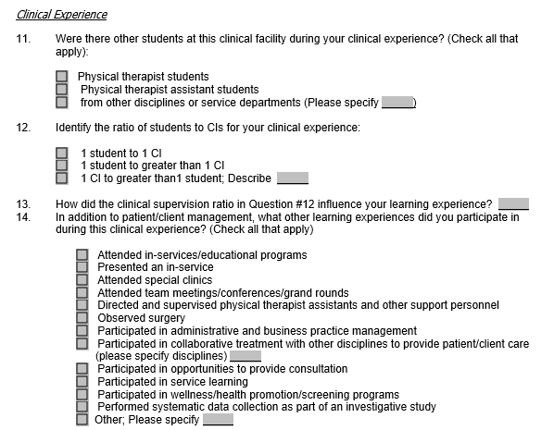
Physical Therapist Student Evaluation: Clinical Experience and Clinical Instruction
Tool was first published in 2003 and updated in 2010
National Interprofessional Education Consortium

Slide 107
References/Links
Commission on Accreditation in Physical Therapy Education. Standards and Required Elements for Accreditation of Physical Therapist Education Programs.
http://www.capteonline.org/uploadedFiles/CAPTEorg/About_CAPTE/Resources/
Accreditation_Handbook/CAPTE_PTStandardsEvidence.pdf
Interprofessional Education Collaborative Expert Panel. (2011). Core competencies for interprofessional collaborative practice: Report of an expert panel. Washington, D. C.: Interprofessional Education Collaborative.
Interprofessional Education Collaborative. (2016). Core competencies for interprofessional collaborative practice: 2016 update. Washington, DC: Interprofessional Education Collaborative.
Physical Therapist Manual for the Assessment of Clinical Skills, 2 Ed. Austin, TX: Texas Consortium for Physical Therapy Education and Research Foundation; 2015.

Slide 108
References, continued
Physical Therapy Student Evaluation: American Physical Therapy Association, Department of Physical Therapy Education, Alexandria,VA, 2003.
Thistlethwaite, J. & Moran, M. on behalf of the World Health Organization Study Group on Interprofessional Education and Collaborative Practice (2010). Learning outcomes for interprofessional education (IPE): Literature review and synthesis. Journal of Interprofessional Care, 24, 503513.
World Health Organization (WHO). (2010). Framework for action on interprofessional education and collaborative practice. Geneva: World Health Organization.
https://ipecollaborative.org/IPEC.html

Slide 109
References
http://www.apta.org/uploadedFiles/APTAorg/About_Us/Policies/Judicial_Legal/ProfessionalismCoreValues.pdf accessed September 21, 2016.
http://www.nationalacademies.org/hmd/Global/News%20Announcements/Crossing-the-Quality-Chasm-The-IOM-Health-Care-Quality-Initiative.aspx accessed September 21, 2016.
http://www.aacn.nche.edu/education-resources/ipecreport.pdf accessed September 21, 2016.
http://www.rwjf.org/en/library/research/2013/02/the-revolving-door--a-report-on-u-s--hospital-readmissions.html accessed September 23, 2016
http://www.ihi.org/engage/initiatives/TripleAim/Pages/default.aspx accessed September 23, 2016.
https://www.cms.gov/Medicare/Quality-Initiatives-Patient-Assessment-Instruments/QualityInitiativesGenInfo/index.html?redirect=/qualityinitiativesgeninfo accessed September 30, 2016.
https://innovation.cms.gov/initiatives/index.html#views=models accessed September 30, 2016.
National Interprofessional Education Consortium

Slide 110
References
Joesph S, Diack L, Garton F, Haxon J. Reflections on delivering interprofessional education in practice. 2014. J of Practice Teaching & Learning 13(2-3), pp32-44.
Christopherson TA, Troseth MR, Clingerman EM. Informatics-enabled interprofessional education and collaborative practice: A framework-driven approach. Journal of Interprofesional Education and Practice (2015) 10-15.
Effective Interprofessional Education: Development, Delivery and Evaluation. Freeth D, Hammick M, Reeves S, Koppel I, Barr H. 2005. Blackwell Publishing. Oxford, UK (p41).
Interprofessional Education: Making It Happen. Ed Bluteau P and Jackson A. (2009) Palgrave Macmillan, Hampshire, UK. ISBN: 987-0-230-57447-2.
APTR (Association for Prevention Teaching and Research). (2009). Interprofessional education assessment and planning instrument for academic institutions. (http://www.aptrweb.org/?page=IPE_Assessment). Accessed August 23, 2016.
Institute of Medicine. Measuring the Impact of Interprofessional Education on Collaborative Practice and Patient Outcomes. Washington, DC: The National Academies Press, 2015. doi:10.17226/21726.
National Interprofessional Education Consortium

Slide 111
References
The Joint Commission on Accreditation of Healthcare Organizations. Facts about the “Do Not Use list” of abbreviations. June, 2016. (https://www.jointcommission.org/facts_about_do_not_use_list/) Accessed August 21, 2016.
Association for Prevention Teaching and Research. Interprofessional educational assessment and planning instrument for academic institutions. (http://www.aptrweb.org/?page=IPE_Assessment) Published 2009. Accessed August 24, 2016.
Interprofessional Education Collaborative. (2016). Core competencies for interprofessional collaborative practice: 2016 update. Washington, DC: Interprofessional Education Collaborative.
Ankam N, Levinson M, Jerpbak C, et al. A common language for interprofessional education: the World Health Organization’s international classification of functioning, disability and health (ICF). MedEdPORTAL Publications. 2013;9:9321. (http://dx.doi.org/10.15766/mep_2374-8265.9321). Accessed August 21, 2016.
Schlesinger J, Persky A, Faculty Learning Community. Bloom's taxonomy in action. MedEdPORTAL Publications. 2015;11:10031. (http://dx.doi.org/10.15766/mep_2374-8265.10031). Accessed August 21, 2016.
National Interprofessional Education Consortium

Slide 112
References
The Development and Validation of the Interprofessional Attitudes Scale: Assessing the Interprofessional Attitudes of Students in the Health Professions. Norris J Carpenter JG Eaton J Guo JW Lassche M Pett MA Blumenthal DK; Acad Med. 2015 May 18 .
Dow AW, DiazGranados D, Mazmanian PE, Retchin SM. An exploratory study of an assessment tool derived from the competencies of the interprofessional education collaborative. J Interprof Care. 2014;28(4):299-304. PMID: 24593327
Fike DS, Zorek JA, MacLaughlin AA, Samiuddin M, Young RB, MacLaughlin EJ. Development and validation of the student perceptions of physician-pharmacist interprofessional clinical education (SPICE) instrument. Am J Pharm Educ. 2013;77(9):Article 190.
Parsell, G. and Bligh, J. (1999). The development of a questionnaire to assess the readiness of health care students for interprofessional learning (RIPLS). Medical Education. 33(2), 95­100.
Lie D, May W, Richter-Lagha R, Forest C, Banzali Y, Lohenry K. Adapting the MaMaster-Ottawa Scale and developing behavioral anchors for assessing performance in an interprofessional team observed structured clinical encounter. Med J Online. 2015;20.
Curran V, Hollett A, Casimiro LM, Mccarthy P, Banfield V, et al. Development and validation of the interprofessional collaborator assessment rubric (ICAR). J Interprof Care. 2011 Sept;25(5):339-44. https://www.ncbi.nlm.nih.gov/pubmed/21732723
National Interprofessional Education Consortium

Slide 113
References and Resources:
Bridges DR, Davidson RA, Odegard PS, Maki IV, Tomkowaik J. Interprofessional Collaboration: Three Best Practice Models of Interprofessional Education. Med Educ Online. 2011;16:10:10.3402
Forest CP, Lie DA, Ma SB. Evaluating Interprofessional Team Performance: A Faculty
Rater Tool. MedEdPortal Publications. 2016;12:10447
Howell D. English L Page J. The Rockcastle Project: A study of Interprofessional Practice in a Rural Medical Center. The Internet Journal of Allied Health Sciences and Practice. April 2011, Vol 9 No 2.
Interprofessional Education Collaborative. (2016). Core Competencies for Interprofessional
Collaborative Practice:2016 update. Washington DC: Interprofessional Education
Collaborative
Physical Therapists Clinical Performance Instrument PT- MACS
National Interprofessional Education Consortium

Slide 114
References and Resources:
APTA Website
Interprofessional Collaborative Practice and Learning Environments (ICP&LE) Website
http://www.jefferson.edu/university/interprofessional_education/programs/collaborative-practice-initiatives.html
http://www.ncbi.nlm.nih.gov/pmc/articles/PMC3081249/
http://www.tandfonline.com/doi/full/10.1080/13561820701352531
http://www.ipe.uwo.ca/Administration/case.html
http://www.ipe.uwo.ca/Administration/case.html

Slide 115

CONTACT US
Cheryl Resnik – resnik@usc.edu
Pamela Ritzline – pritzline@walsh.edu
Robert Nithman – Bnithman@midwestern.edu
Samantha Brown – skbrownPT@gmail.com
Debora Brown – brownded@musc.edu
National Interprofessional Education Consortium

