Slide 1
President’s 2021 Report
Mark F. Reinking, PT, PhD, SCS, FAPTA
Regis University

Slide 2


Slide 3
ACAPT Board of Directors 2020-2021
Peter Altenburger, PT, PhD – Indiana University
John Buford, PT, PhD – THE Ohio State University
Julia Chevan, PT, PhD – Springfield College
Scott Davis, PT, EdD – Marshall University
Mary Dockter, PT, PhD – University of Mary
Marie Johanson, PT, PhD – Emory University
Emmanuel John, PT, DPT, PhD, MBA – Chapman University
Mark Reinking, PT, PhD, FAPTA – Regis University
Michael Sheldon, PT, PhD – University of New England

Slide 4
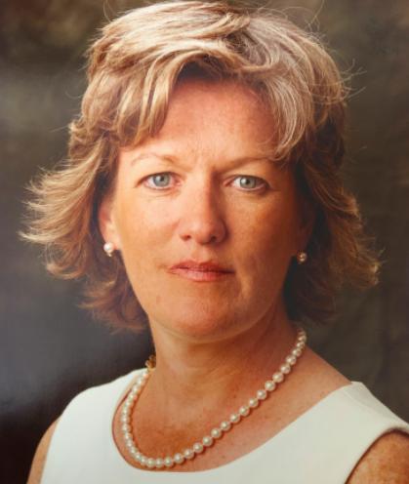

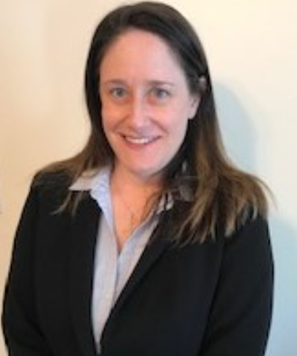
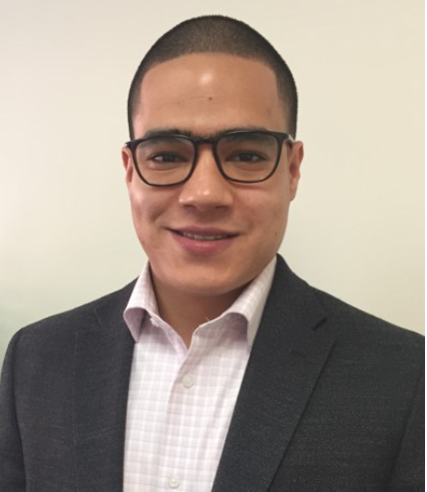
ACAPT Staff 2020-2021
Sandy Brooks, Executive Director
Eleanor Trice, Communications & Data Strategist/Special Projects Lead
Louise Murgia, Database and Office Administrator
Jamil Tadlaoui, Events and Partner Strategies Coordinator

Slide 5

The year past . . .
This Photo by Unknown Author is licensed under CC BY-ND

Slide 6

ACAPT Membership
95%
Eligible Institutions: 266
Includes accredited programs and programs in candidacy
Number of MEMBER INSTITUTIONS: 252

Slide 7









Welcome - first time members

Slide 8
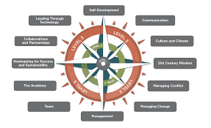
2018-2021 Strategic Plan
Academic innovation
Academic leadership & advocacy
Knowledge to elevate health care

Slide 9

2022-2025 ACAPT Strategic Plan

Slide 10

2021-24 ACAPT Strategic Plan

Slide 11
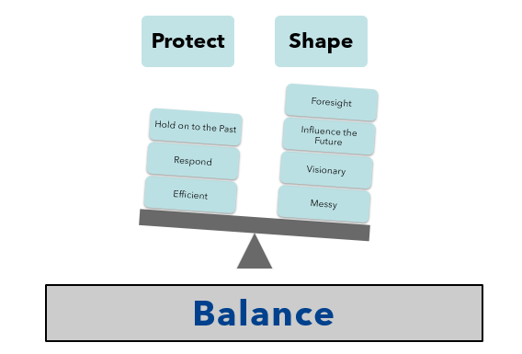
2021-2024 ACAPT Strategic Plan

Slide 12
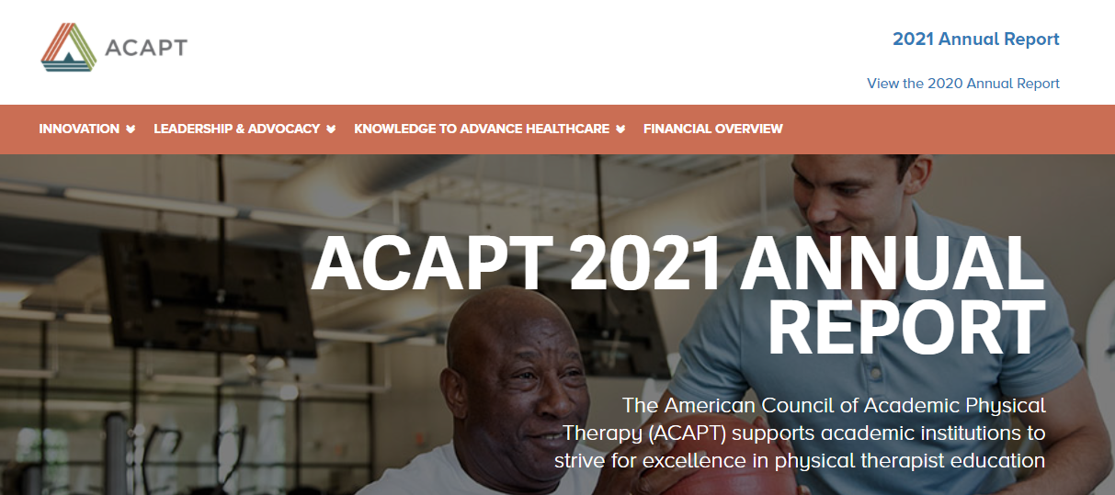
2021 Annual Report

Slide 13

DEI Initiatives
National Equity, Diversity, and Inclusion Commission
DEI Summit: Building Partnerships, Creating Space and Developing Opportunities to Increase Racial and Ethnic Diversity in Physical Therapy
June 27-29 2022
The Ohio State University
DEI Consortium
    Listening sessions
    Webinars
    DEI resources

Slide 14
Our history . . . Informing our future
Birthed from Academic Administrators' Special Interest Group
2014: Incorporated as an organization in the Commonwealth of Virginia
Committed to supporting academic institutions and clinical partners and focused on improving academic physical therapy
Consider all the work that has been accomplished by our consortia, committees, and task forces, including multiple peer reviewed publications and presentations

Slide 15


2021 Accomplishments
Formation of Advocacy Committee
Task Forces
    Excellence Recognition Model
    Explore Data and Technology to Evaluate Program Outcomes
    Joint Task Force on Data, Technology, Benchmarks and the Recognition of Excellence

Slide 16

Where we are headed . . .
This Photo by Unknown Author is licensed under CC BY

Slide 17
Where we are headed . . .
We must commit to taking tangible steps to address the DEI issues in our programs and in our profession. We must build a student body and a professoriate that reflects the diversity of our country, ensure that there are equitable admissions processes, and build inclusive programs.
As part of every program’s ongoing journey towards excellence, we’re building a culture of continuous improvement. This will require the collection of and access to comprehensive data in order to establish trends that promote excellence.
ACAPT should emerge as the influential voice in the pursuit of excellence for academic physical therapy

Slide 18

Where we are headed . . .

Slide 19
Although ACAPT acts with a deep and abiding commitment to excellence in education and leadership in the academy, its agenda is at risk if the culture does not fully embrace the need to proactively transform education in ways that anticipate the changes we will continue to see in health and health care . . . The entire academic community must engage in the transformative process for physical therapy education. Unity is the ideal conclusion.
Deusinger SS & Sanders B. J Phys Ther Ed. 2017;31(3):100-104

Slide 20

Gratitude . . .
To our leaders –elected, appointed
To our participants –consortia, committees, task forces, work groups, panels, speakers
To you, our member institutions and the faculty
The future is bright, and it is ours!

