Slide 1




a collaborative effort by:

Slide 2


THANK YOU TO
for sponsoring ELC 2022 Educational and
Platform presentations!

Slide 3
Becoming a Change Agent: Academic Role in Teaching Advocacy to the Next Generation
ACAPT Advocacy Task Force Members

Slide 4


Speakers from Task force
Jill Heitzman, PT, DPT, PhD, Maryville University in St. Louis
Midwest Region
Linda B. Horn, PT, DScPT, MHS, University of Maryland School of
Medicine, Department of Physical Therapy and Rehabilitation Science
Middle Atlantic
Randy B. Kolodny, PT, DPT, MA, Seton Hall University
Region
Laurie C. Neely, PT, DPT, University of Central Florida
South Atlantic
Robert W. Nithman, PT, DPT, PhD West Coast University, Center for Graduate Studies
Region

Slide 5
Objectives
1. Delineate the role of the newly formed ACAPT Advocacy Committee.
2. Develop an agreed upon operational definition of advocacy across all levels and populations.
3. Promote change agent professionals who advocate for relevant stakeholders.
4. Integrate selective active learning strategies to develop advocacy skills within the next generation of physical therapists and interprofessional teams.
5. Relate advocacy across the various domains of practice and professionalism to advance the profession, healthcare outcomes, and DEI initiatives.
6. Justify the need and strategies to have advocacy activities threaded through a curriculum.

Slide 6
ACAPT Advocacy Committee’s Role
The Advocacy Committee is designed to ensure that ACAPT plays an active and effective role in influencing outcomes that contribute to the achievement of academic excellence for all physical therapist education programs and their clinical partners. The Committee should help position ACAPT as the representative body of all physical therapist education programs and their clinical affiliates.
Notes:
Origins of the Committee:
ACAPT BoD Formed, etc.
Check with Sandy re: what we can put on this now
Description: The Advocacy Committee is designed to ensure that ACAPT plays an active and effective role in influencing outcomes that contribute to the achievement of academic excellence for all physical therapist education programs and their clinical partners. The Committee should help position ACAPT as the representative body of all physical therapist education programs and their clinical affiliates.

Slide 7

Important Questions
What is advocacy & why is it important to teach our students?
How do we teach advocacy to our students? Clinicians?
What are some examples of course level advocacy objectives?
What are some activities that can promote engagement?
THINK-PAIR-SHARE
Notes:
End of presentation question: Are there advocacy competencies that should be included in all physical therapy curricula in professional education programs?
Removed: What are the facilitators and barriers to participation in advocacy-related activities?

Slide 8

What is advocacy?
Athink-pair-share
Notes:
Chose 1-2 samples as basic talking points but emphasize APTA definition
Support for an idea, plan, or way of doing something (https://dictionary.cambridge.org/dictionary/english/advocacy
Support for or recommendation of a particular cause or policy (https://www.merriam-webster.com/dictionary/advocacy)
The act of speaking on the behalf of or in support of another person, place, or thing/ act of pleading or arguing in favor of something, such as a cause, idea, or policy; active support(https://www.yourdictionary.com/advocacy)
Striving to be emphatic and vigorous, functioning (speaking, acting, writing) with minimum conflict of interest, on behalf of the sincerely perceived interests of a person or group, in order to promote, protect and defend the welfare of, and justice for, either individuals or groups.
(https://www.rightsinaction.org/home/what-is-advocacy/)

Slide 9
Purpose of Advocacy
Advocacy is active promotion of a cause or principle
Advocacy involves actions that lead to a selected goal
Advocacy is one of many possible strategies,or ways to approach a problem
Advocacy can be used as part of a community initiative, nested in with other components.
Advocacy is not direct service
According to APTA…https://www.apta.org/advocacy
Notes:
Remove and integrate elsewhere

Slide 10


Types of Advocacy
Professional level
Patient level
Individual level
Organizational level
Societal level
Notes:
Each sections should cover (bullets):
Definition / what it is
Resources
Success stories

Slide 11
Important Questions
What is advocacy & why is it important to teach our students?
Do we teach these different types of advocacy to our students? Clinicians?
What are some examples of course level advocacy objectives?
What are some activities that can promote engagement?
THINK-PAIR-SHARE
Notes:
End of presentation question: Are there advocacy competencies that should be included in all physical therapy curricula in professional education programs?
Removed: What are the facilitators and barriers to participation in advocacy-related activities?

Slide 12
Professional advocacy
Notes:
Though remember, there is overlap between the different types of advocacy

Slide 13
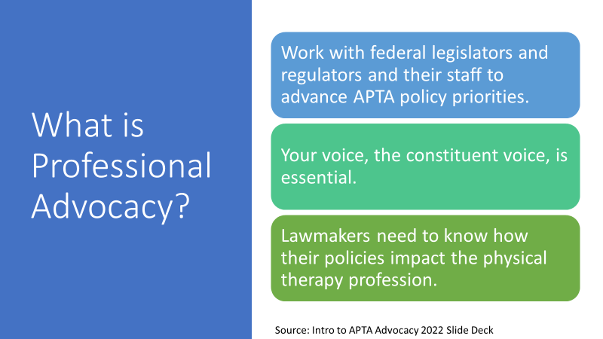

Slide 14
Understanding the difference between law, policy and regulations is essential in our journey to teach students to become professional advocates.

Slide 15
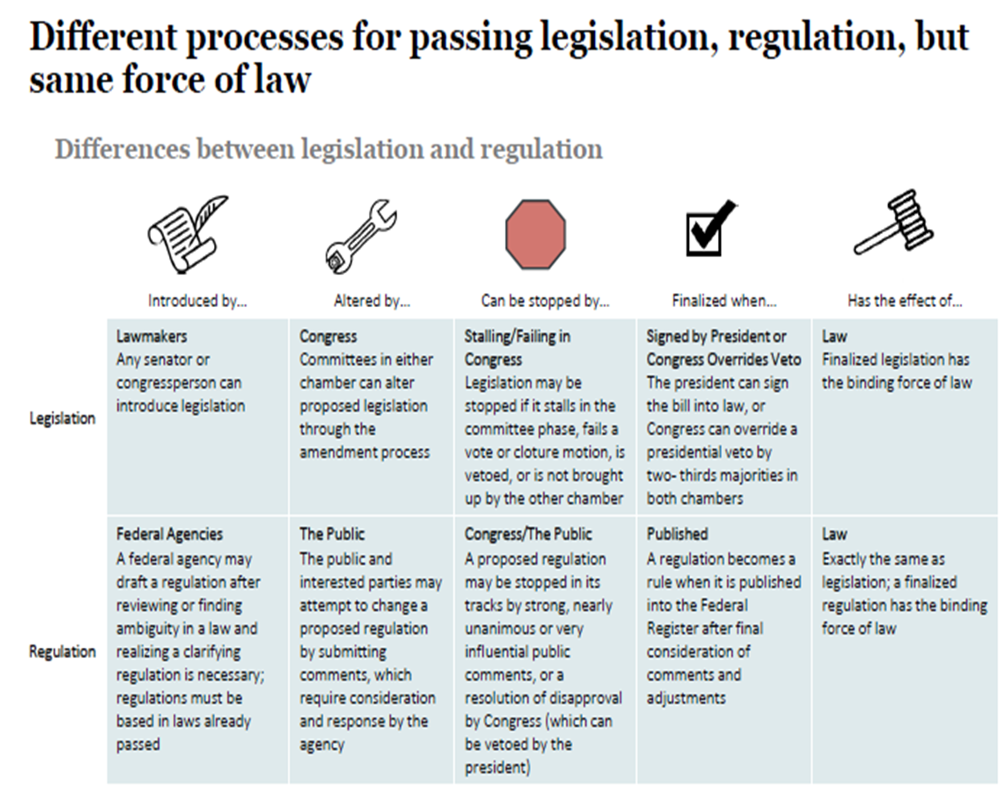
National Journal

Slide 16
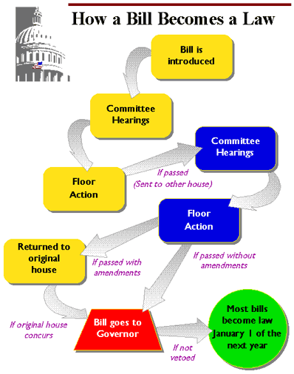
What you should know about each bill:
Status of the Bill
Committee
Sponsors
History (This will tell you how fast the bill is moving through legislature)
Opposition
What you should know about each legislator:
Are they in the House or the Senate?
Which committees are they on?
  Will this bill come directly to them?
Which district in the state do they represent?
  Are you in that district?
Notes:
Maryland example (image)

Slide 17

Government Affin-flights
Health Policy and Payment
Public Relations
PAC: Federal and State
State Chapters
Aaron Bishop, VP Public Affairs
Justin Elliott, VP Government Affairs
Daniel Markels, Manager of State Affairs
Notes:
APTA has hired Aaron Bishop as APTA’s vice president of public affairs, effective Nov. 1 2021
Justin Elliott is vice president of government affairs at APTA, where he has led the association's legislative, public policy, and political efforts on Capitol Hill since 2015.
Daniel Markels is the manager of state affairs at APTA

Slide 18
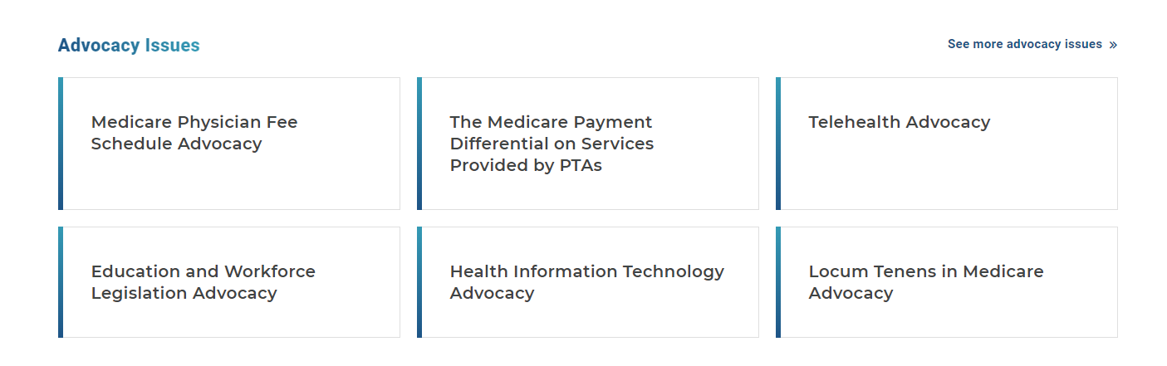

Slide 19
What Should Students Know About These Advocacy Issues?
Administrative Burden
Direct Access
Essential Health Benefits
Education and Workforce Advocacy
Fair PT Copays
HIT and Telehealth
IDEA & ESSA
Medicaid
Medicare Opt-Out, Locum Tenens, Fee Schedule
Medicare Payment Differential on PTA Services
Medicare Cuts for PT 2023 and Beyond?
Rural Health Clinics and Community Centers
Safe Pain Management
Term & Title Protection

Slide 20
What is Lobbying?
•APTA Advocacy efforts combine expert analysis, a consistent lobbying presence, and the participation of our members.
•APTA lobbyists: Brian Allen, JD, Michael Matlack
•https://www.opensecrets.org
Notes:
Suggest combining slides 17&18

Slide 21
Where can we learn about the complexities of lobbying?
•Nonpartisan, independent and nonprofit, OpenSecrets is the nation's premier research group tracking money in U.S. politics and its effect on elections and public policy.
•Our mission is to track the flow of money in American politics and provide the data and analysis to strengthen democracy. Our vision is for Americans to use this knowledge to create a more vibrant, representative and accountable democracy.
https://www.opensecrets.org/about

Slide 22
Advocacy Coalitions
•APTA often works with other organizations on mutually beneficial legislation and regulations for the betterment of the health care system, the physical therapy profession, and the patients we serve.
•Example Trialliance: APTA, AOTA, ASHA
•Payment coalitions
•Practice coalitions
https://www.apta.org/apta-and-you/partnerships/coalitions

Slide 23
Grassroots Advocacy
•People contacting their elected officials about important policy issues.
•Meeting with lawmakers in your district to discuss
works to unite your community and encourage the public to approach your legislators and other government officials themselves.

Slide 24
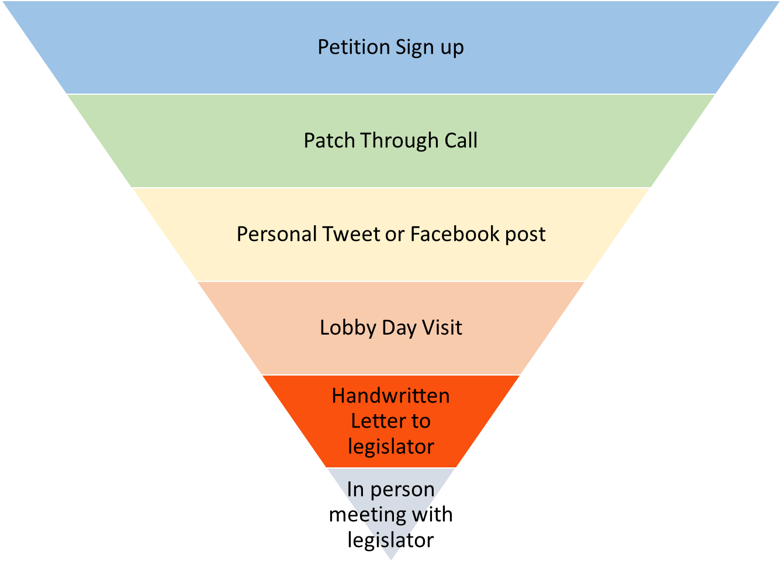
Funnel of influence

Slide 25

A CALL TO ACTION
Taking action to promote the profession, with an emphasis on removing or minimizing barriers to provide services.
When we consider advocacy, we do not often think about our mission for our profession.
Concerns such as parity (being reimbursed at the same rate as other health professionals with comparable training), public recognition, accurate representation of our profession, and employment opportunities are important if we are to practice our craft.
We must know and promote our worth and recognize that if we are not strong and healthy as a profession, we cannot help others. Therefore, professional advocacy must be a top priority for all physical therapists

Slide 26

Federal advocacy is a Marathon, not a sprint!

Slide 27
Big Win: APTA-Supported Medicare Fix Passes Congress Dec 2021
Our members consistently stepped up when APTA called for action — those contributions were absolutely invaluable to this legislation being passed,“
"Lawmakers heard our voices loud and clear. APTA members should congratulate themselves on their efforts.“
– Laura Keivel, APTA Grassroots Affairs & Political Affairs Specialist
https://www.apta.org/news/2021/12/10/medicare-fix-passes-senate?utm_source=Informz&utm_medium=email&utm_campaign=Informz%20email%20link&_zs=044fV1&_zl=C3l58
#FightTheCut

Slide 28
Activity: Understanding Policy
Reading / Debating Position Papers and APTA Public Policy Priorities
“The American Physical Therapy Association shapes policy issues that impact our profession and the patients and clients we serve.”
Other Activities
Panel discussions/presentations to students by state chapter leaders
https://www.apta.org/advocacy/position-papers
https://www.apta.org/advocacy/issues/apta-public-policy-priorities

Slide 29
Student Engagement: APTA Promotes:
•Student Advocacy Challenge (time varies)
•Take Action (one to five minutes)
•National Advocacy Dinners (one to five hours)
•Arrange a legislator's visit to your program (one to five hours)
•Flash Action Strategy (one to two days)
•State legislative day (one to two days)
•Core Ambassador (up to one year)
•APTA Student Assembly Project Committee (up to one year)
Student Special Interest Groups (one+ year)

Slide 30
Success Stories
Maryland: Opposition to a bill expanding the scope of practice for athletic trainers
  Students participated in state advocacy day to oppose this bill (prior to advocacy day, students were presented and educated on talking points)
  Student with an athletic training background testified in the State Senate hearing with a faculty member
    Be proactive: There were a few students who were ATCs that did not agree with APTA Maryland’s position
    Alternatives
      Attend in person and not speak to the ATC issue
      Not attend and write to legislators about other pertinent issues
      Need to consider personal advocacy
Notes:
Linda, feel free to edit/change. I just thought this was a good example that had a lot of student involvement. This is a great example. It also demonstrates possible problems that need to be managed proactively.

Slide 31
Success at Local Level
Statewide student led zoom advocacy night to meet leaders of the state chapter and local politicians supporting PT
Legislators hearing from students re: these issues as they are the future employees in the state:
Athletic trainer bill
Direct Access keeping students in the state
What about YOU?

Slide 32


Slide 33
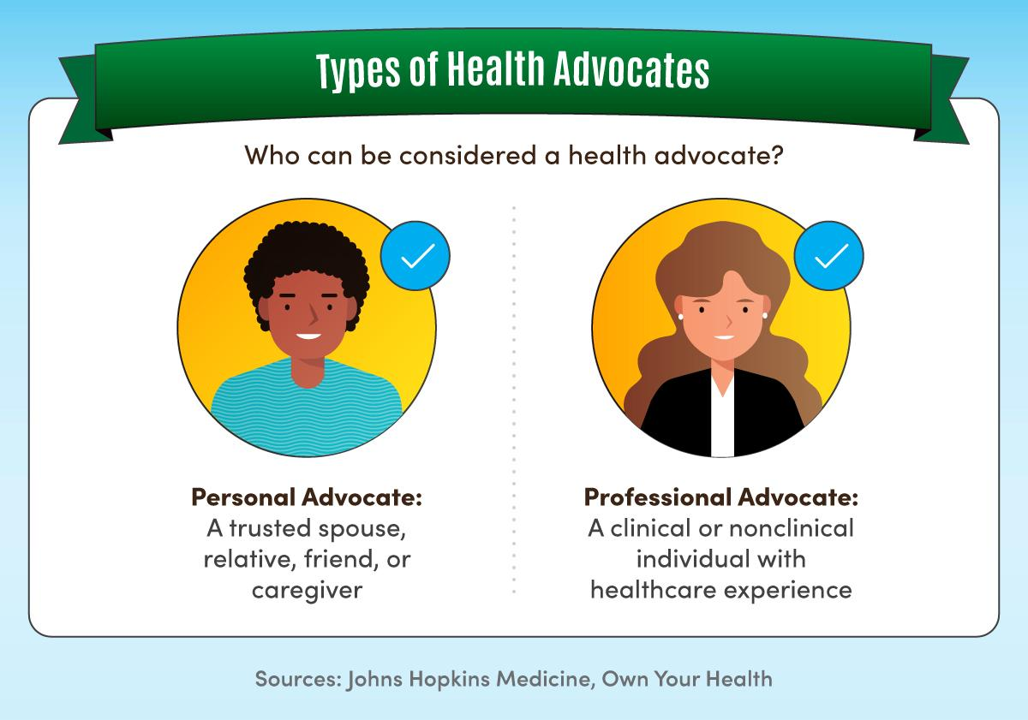
Definition
Role of advocating for patients when they either can’t or don’t know how to advocate for themselves
(https://www.chcollege.org/what-is-patient-advocacy/)

Slide 34
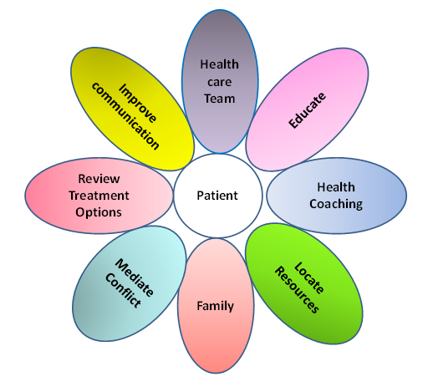

Slide 35
Success Stories
Letters of medical necessity
Interprofessional health team referrals
Community organization connections for ramps, assistive devices, camps
IPE events re: other resources
Veteran benefits, Medicaid, other charity care/financial assistance
Partnerships for outreach pro bono services
Teaching caregivers, respite care education, caregiver burden education
Notes:
SDOH

Slide 36
Resources for Patient Advocacy
Medicare Compare Site https://www.medicare.gov/care-compare
Help choosing a Medicare Provider (Nursing homes, physicians, hospitals, etc.)
Choose Wisely https://www.choosingwisely.org/
Identifies > 500 tests and procedures and encourages doctors, therapists and
patients to discuss, research, and possibly get second opinions, before proceeding with them.
Office of the Patient Advocate - California https://www.opa.ca.gov/
​Committed to providing quality health care data for informed consumer decision making.​​​​​​​​​​​​​​​​​​​
Many others including the Office of the Ombudsperson
APTA and Academies website for community/patient education
Notes:
Discuss health equity and disparities, price transparency, surprise medical bills, care for insured and underinsured, entry-level students learning about and understanding how insurance works and being able to explain this to patients and family members
Other sources:
Patient Advocate Foundation https://www.patientadvocate.org/
National Patient Advocate Association - https://www.npaf.org/
https://www.myshortlister.com/health-advocacy-programs/vendor-list

Slide 37
3 Types of Advocacy to teach patients/caregivers
Self-advocacy
Individual advocacy
Systems advocacy
*Accommodations advocacy/education on ADA
West Virginia University Center for Excellence in Disability
Notes:
Self-Advocacy - Self-advocacy refers to an individual's ability to effectively communicate, convey, negotiate or assert his or her own interests, desires, needs, and rights (VanReusen et al., 1994).
Self-advocacy means understanding your strengths and needs, identifying your personal goals, knowing your legal rights and responsibilities, and communicating these to others.
Self-Advocacy is speaking up for oneself!
Individual Advocacy In individual advocacy a person or group of people concentrate their efforts on just one or two individuals. According to the group Advocacy for Inclusion "Advocacy is having someone to stand beside you if you think something is unfair or that someone is treating you badly and you would like to do something to change it."
There are two common forms of individual advocacy - informal and formal advocacy. When people like parents, friends, family members or agencies speak out and advocate for vulnerable people this is termed informal advocacy. Formal advocacy more frequently involves organizations that pay their staff to advocate for someone or for a group of individuals.
Systems Advocacy Systems advocacy is about changing policies, laws or rules that impact how someone lives their life. These efforts can be targeted at a local, state, or national agency. The focus can be changing laws, or simply written or unwritten policy. What is targeted depends on the type of problem and who has authority over the problem (Brain Injury Resource Center, 1998).

Slide 38

Personal advocacy

Slide 39

What is Self Advocacy?
Speaking out for yourself
Acting on your behalf
Making choices and decisions

Slide 40

Definition: Self Advocacy
Refers to an individual's ability to effectively communicate, convey, negotiate or assert his or her own interests, desires, needs, and rights (VanReusen et al., 1994).
Means understanding your strengths and needs, identifying your personal goals, knowing your legal rights and responsibilities, and communicating these to others.
Speaking up for oneself! (https://cedwvu.org/resources/types-of-advocacy/)

Slide 41
Success Stories
Accommodations for during school
Service Dog Accommodation for during class
Essential functions to perform tasks in lab and clinics
Portfolios have guided job searches
Mock interviews: various formats: round robin interviews, group interview, team interview: reduce anxiety of those going on interviews
Video interviews for self critique
Increased number of post graduate applications to residencies
Communication in clinic examples: CI doing a test/measure different than student taught, on day one student has a full patient load, Need a different feedback style (too much/too little)

Slide 42
Organizational/Facility Advocacy

Slide 43
Definition
Organizational advocacy offers a new way to look at the interaction between people and their organizations and their community
Central Values that drive the recommendations and experiences
sharing and communicating the mission of the organization to others, activities sometimes referred to as ambassadorship
Educate others about your organization

Slide 44
Internal Advocacy
External Advocacy
Benefit of PT
When to refer to PT
PT role in Healthcare team
Ergonomics assessment/training of other departments
Advertizing your organization at community events
Community health fairs

Slide 45
Success Stories
Faculty PT Practice on Campus
Outreach ProBono Clinics
Service to community:
Special Olympics FUNfitness,
Booths at Community Fairs/Marathons
Stretching booth at 5K run,
Teams for Alzheimer walks or other diseases/issues

Slide 46


Slide 47


Slide 48
Definition
Social advocacy is about looking at the problems of human rights and injustice from a systemic point of view.
While Advocacy is the act of supporting an idea, need, person, or group; social advocacy is the concept of empowering a team or group of individuals to support your a strategy by sharing content and connecting with a larger audience.
Social advocacy is working to connect with like-minded people, organisations, groups, and institutions so that they can work together to achieve justice.
***Strong connection to the Social Determinants of Health which connects to the ICF module of patient care and Health Disparities

Slide 49
Health Advocacy
•“Combination of individual and social actions designed to gain political commitment, policy support, social acceptance and systems support for a particular health goal or program.”
World Health Organization

Slide 50
Success stories
Black Men on Campus Panel Discussion
Awareness of accessibility issues on campus and in community
Stereotypes in media/ads/movies

Slide 51
How do we get all faculty on board?
think-pair-share

Slide 52


Slide 53
Issues/ Barriers
Core Faculty
Barriers: lack of time, lack of knowledge, lack of resources
Clinical Faculty
Barriers: lack of time, lack of knowledge, lack of resources
APTA doesn’t do anything for me and costs too much
WHAT ARE YOU DOING TO GET OTHERS ON BOARD TO TEACH ABOUT ADVOCACY?

Slide 54


Slide 55
Moving into didactic avenues of teaching advocacy

Slide 56
CAPTE Standards
7D1 Adhere to legal practice standards, including all federal, state, and institutional regulations related to patient/client care and fiscal management.
7D13 Participate in professional and community organizations that provide opportunities for volunteerism, advocacy and leadership.
7D14 Advocate for the profession and the healthcare needs of society through legislative and political processes.

Slide 57
Important Questions
What is advocacy & why is it important to teach our students?
How do we teach advocacy to our students? Clinicians?
What are some examples of course level advocacy objectives?
What are some activities that can promote engagement?
THINK-PAIR-SHARE
Notes:
End of presentation question: Are there advocacy competencies that should be included in all physical therapy curricula in professional education programs?
Removed: What are the facilitators and barriers to participation in advocacy-related activities?

Slide 58
Objectives and activities: Professional Advocacy
Objectives
Promote provision of physical therapy services without the need for referrals from other healthcare providers.
Explain the differences between legislation and regulation.
Describe how a bill becomes a law.
Discuss current federal, state and local policy priorities.
Identify your federal, state and local representatives and ways to effectively communicate with these representatives.
Debate the merits of position papers published by the APTA.
Activities
Introduction to APTA Legislative Action Center
Student Advocacy Days (including preparation labs to understand governmental procedures and talking points)
Student participation hearings (including testimonies)
Develop presentations or activity for each pillar
Notes:
Professionalism

Slide 59
Objectives and Activities: Patient Advocacy
Objectives
Advocate for policies that achieve outcomes that are in the best interest of patients/clients
Accept responsibility as an advocate for the provision of appropriate health care services for his/her patients/clients.
Demonstrate assertiveness skills in order to have the needs made explicit, to manage criticism, and advocate for patient/client needs
Addresses patient/client needs for services by consulting other members of the health care system as needed to facilitate optimal patient/client outcomes;
Advocate for patient needs related to therapy visits/interventions, equipment, interprofessional healthcare team services, healthcare placement needs/services, and financial/support services
Activities
IPE events focused on each of the IPEC core competencies to help PTs advocate for patients within the healthcare team
Role playing of scenarios
Find out about agencies in their community that may include fitness centers, health programs, etc
Develop letters of justification for patient needs that may include: equipment, continued therapy, inpatient rehab qualification
Notes:
Patient advocacy

Slide 60
Objectives and Activities: Personal Advocacy
Objectives
Develop advocacy skills by Identifying and discussing the potential personal and professional issues when considering job opportunities
Describe advocacy methods to determine your job objective and pursuing your first job as a physical therapist
Utilize effective negotiation skills when interviewing for a PT position
Reflect on potential personal and professional issues when considering job opportunities in order to become a self advocate as well as advocate for the profession
Activities
Utilize a SWOT analysis for identifying personal strengths/weaknesses
Develop a personal mission statement
Develop portfolio
Mock job interviews
Alumni panels to discuss their experiences
Professional communication in clinical education to reach expectations, altered feedback, handle conflict–Your own the journey!
Notes:
Personal advocy

Slide 61
Objectives and Activities: Organizational Advocacy
Objectives
Analyze the contributions of PT in collaboration with other healthcare practitioners which facilitate effective and efficient patient care management
Analyze health care environment today within the contemporary systems of organizations affects the practice of physical therapy on a daily basis
Upholds professional/social responsibilities when interacting with other health care members;
Provide consultation to individuals, businesses, schools, government agencies or other organizations;
Activities
Develop market and outreach plans for a business
Develop IPE programs in community and in the facility
Develop IPE Student Council and activities
How to advocate for the PT within a specific setting: early order of PT in acute care, fall prevention in NH,
Notes:
Organizational advocacy

Slide 62
Objectives and Activities: Social Advocacy
Objectives
Respond to conflict to affect a resolution that improves overall health care of patients and society
Value the role of the PT in the Professional Organization at local, state and national level to ensure the health of the patient, the professional and society.
Utilizes the knowledge of health care delivery systems to enhance patient/client access to quality care.
Addresses prevention, wellness, and health promotion needs of individuals, groups and communities in the primary, secondary and tertiary settings
Demonstrates that a physical therapist has professional/social responsibilities beyond those defined by work expectations and job descriptions;
Integrate health care service and be accountable for addressing the majority of personal and societal health care needs
Promotes programs that improves health and wellness among patients/clients and in the community at large;
Activities
1 Attend one meeting outside of PT that is not a CEU course but offered by another organization/community event/profession
2. Compare/Contrast health delivery systems and settings
3. Develop a community health fair/screening/education session
4. Perform ergonomics assessments
Notes:
Societal advocacy

Slide 63
Resources

Slide 64
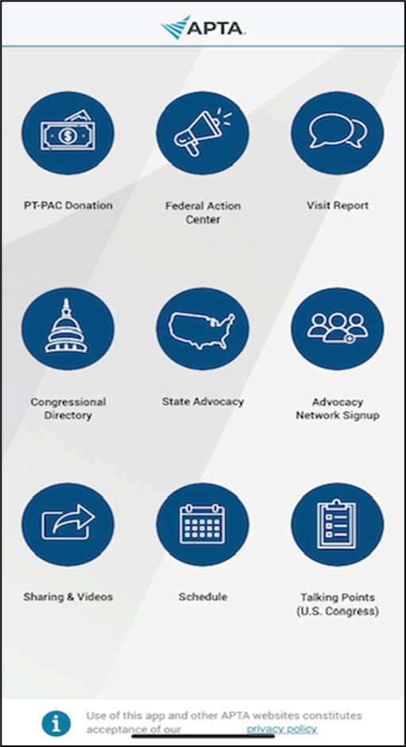
Advocacy Tools for You
Legislative Action Center
APTA members only
Patient Action Center
Public and shareable
APTA Advocacy App
Advocate in minutes from your phone

Slide 65
Advocacy Issues Impacting the Professional and Patients apta.org/advocacy/issues
APTA Advocacy Network apta.orga/advocacy/apta-advocacy-network
PT-PAC ptpac.org
PT Proud ptproud.org

Slide 66
What is Advocacy?
Quotes from Students after Lobby Day
Advocacy is a continuous process that needs courage and commitment
Advocacy is a learning process that allows interaction with other people to work together for a common goal
Advocacy is building relationships with other people
Advocacy is publicly supporting a cause, idea or development project to move forward to achieve a greater good for more people
Advocacy is being active supporter in favor of an idea, suggestion, policy or cause
Advocacy is needed to make change

Slide 67

Where do we go from here?
Moving students from novice to strong advocates
Minimal Essential Competencies in Advocacy
What are they?

Slide 68

Join us for ELC 2023 in Philadelphia!
Save the date:
October 13-15, 2023
pteducationleadershipconference.org

